Slide 1
VX Series Hands On
September 18th, 2024

Slide 2
VX at a Glance
Nautel’s series of compact, rack mount, FM transmitters
Focused on analog FM performance
All new technology and design:
All New RFPA, IPA, Exciter/Controller, etc
New Software (AUI) and firmware (control system, audio processing, protection system, etc)
More options for software limited models and power levels

Slide 3
VX Series
VX (150 to 2kW)
Released Jan 2023
6 Models, VX150 to VX2
VX (3 to 6kW)
Released Sept 2023
5 Models, VX3 to VX6

Slide 4
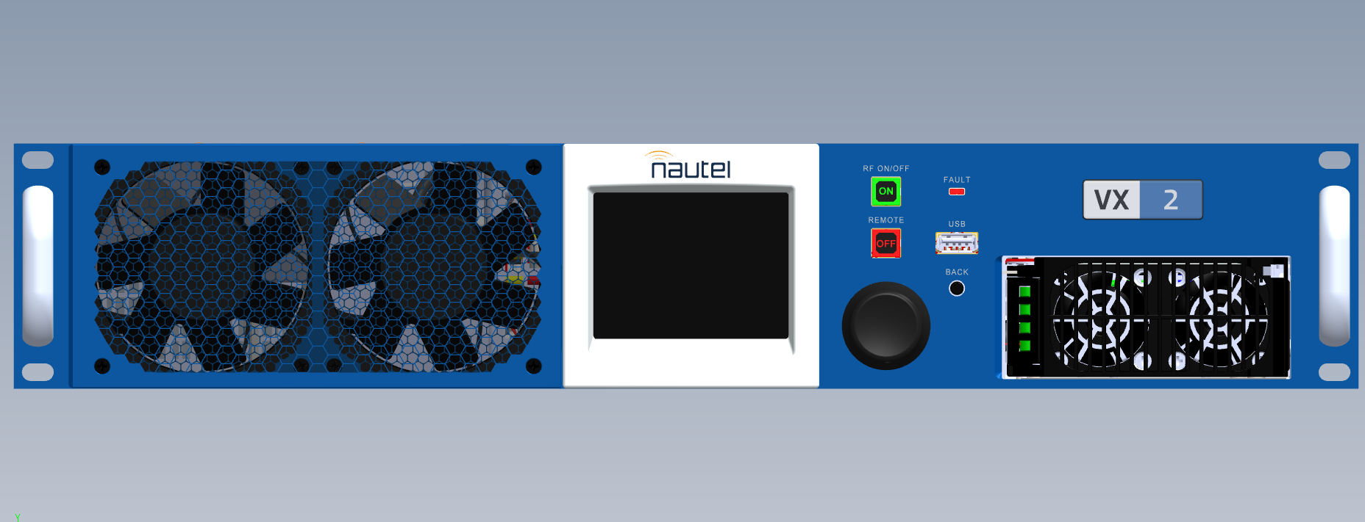
VX Series 150W to 2kW
Hardware Nomenclature | Model | Nameplate Output Power | PA Power Supply | AC Input | # of PA’s | Height (RU)
NARF81 | VX150 | 150 W | 2250W (UG132) | 90 to 265 VAC Single Phase | 1 | 2
 | VX300 | 300 W | UG132
 | VX600 | 600 W
NARF79 | VX1 | 1 kW | 3500W (UG136)
NARF80 | VX1.5 | 1.5 kW |  | 185 to 265 VAC* Single Phase | 2
 | VX2 | 2 kW

Slide 5
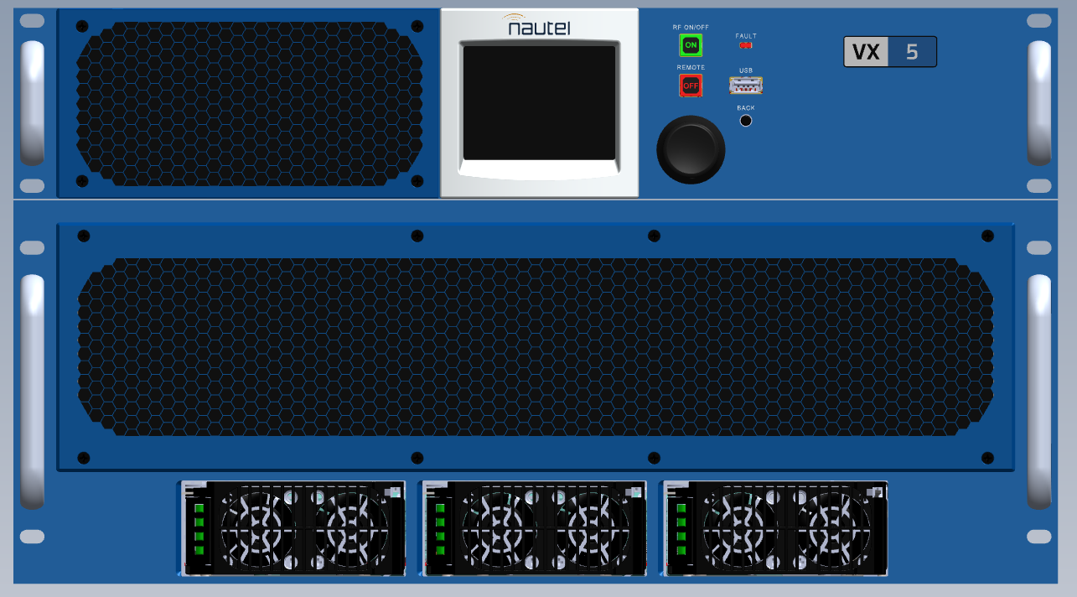
VX3 to VX6
Hardware Nomenclature | Model | Nameplate Output Power | PA Power Supply | AC Input | # of PA’s | Height (RU)
NARF82 | VX3 | 3 kW | 2250W (3xUG132) | 185-265 VAC 1Ø 185-265 VAC 3Ø 320-460 VAC 3Ø | 6 | 6 (4+2)
 | VX3.5 | 3.5 kW
 | VX4 | 4 kW
NARF83 | VX5 | 5 kW | 3500W (3xUG136)
 | VX6 | 6 kW

Slide 6
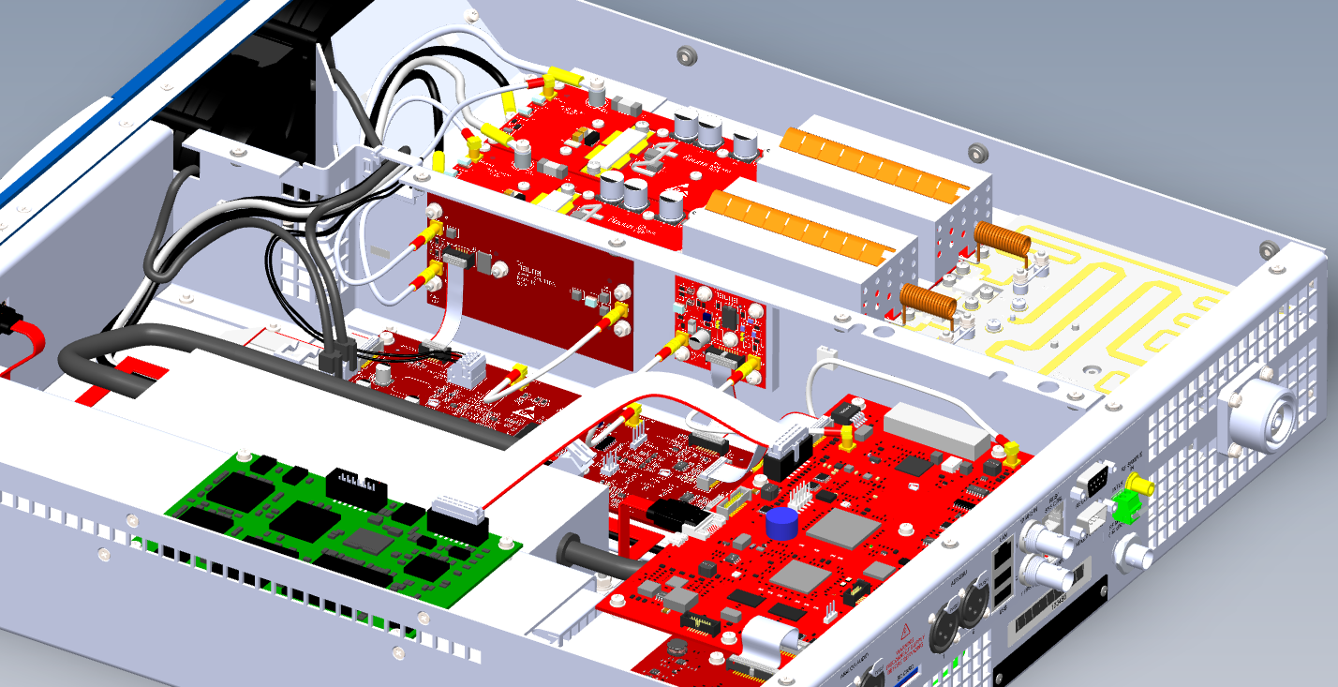
VX Hardware and Architecture
How does it all go together?

Slide 7
One PA System (VX150 to VX1)

Slide 8
Two PA System (VX1.5 & VX2)

Slide 9
Six PA System (VX3 to VX6)

Slide 10
Exciter/Controller (VX3 to VX6)

Slide 11
Amplifier (VX3 to VX6)

Slide 12
System Components
NAPE90 - Exciter
Complete new architecture with integrated device (2 x DSP + ARM)
Removable SD card containing TX Operating System, firmware, calibration, and user configuration
Comparable to VS NAPE87
Performs exciter and controller functions.
2 x AES Digital Audio Inputs
Scaled back discrete remote IO

Slide 13
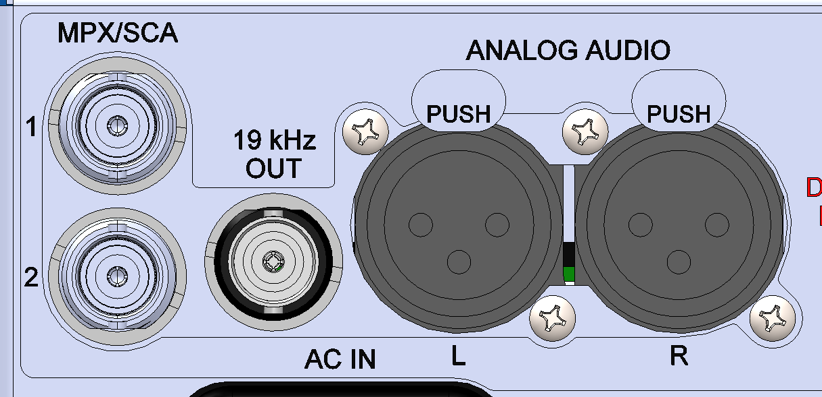
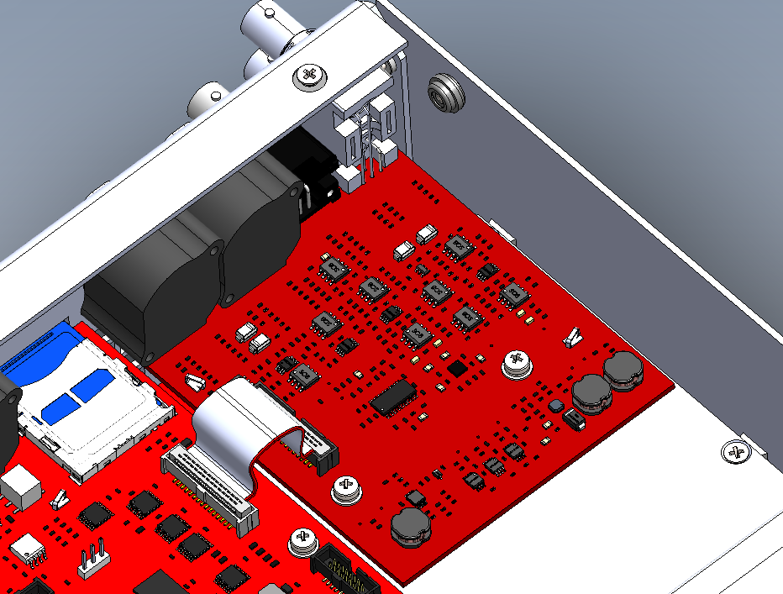
System Components
NAPI189 – Analog Audio Board
Digitizes all analog program inputs
Removes analog circuits from Exciter and isolates it from possible damage.
2 x XLR for analog left & right Inputs
2 x BNC for composite inputs (MPX/SCA)
Provides 19kHz pilot output
No D-Sub adapter required
Audio sources are flexible and independent.

Slide 14
System Components
System Interface Board
Interfaces (connects) various system components.
Contains MCU for measurements, serial communications, PA bias, etc.
Provides unique ID for licensing
Power Supply Interface Board
Distributes AC to both LVPS and PAPS
Measures PA Voltage and Current
Interfaces between SIB and PAPS

Slide 15
System Components
Display
320 x 240p full color LCD
Not a touchscreen
Contains a co-processor to draw the display from basic serial commands.
NAPI201 – Front Panel UI Board
Contains buttons and LEDs for system control and indication
Interfaces between Display and SIB
Provides USB port (identical to rear USB)

Slide 16
System Components
NAPH15 – 2-Way Splitter
1 input to 2 output RF Splitter
Adds DC Bias to each RF drive signal.
VX2 and VX1.5 only
NAPA41 – IPA
Amplifies RF drive from Exciter
+12V device, eliminating the need for a separate IPA power supply

Slide 17
System Components
NAPA40 – Final Stage RF Amplifier
Solderless design for easy replacement
Planar balun replaces coax.
RF Drive and DC Bias are delivered combined on the Coax input.
New 65V LDMOS FET

Slide 18
System Components
RF Combiner (VX1.5&VX2)
2 Way combiner
2 x Shunt inductors for lightning protection
NAPF16 - Low pass filter
Solderless input connection
Paired 1:1 with each power amplifier:
This provides a scalable design
Contains harmonic emissions before combining stages.
Directional Coupler
Provides Forward, Reflected and RF Monitor Samples.
Designed with high directivity to reduce measurement error.

Slide 19
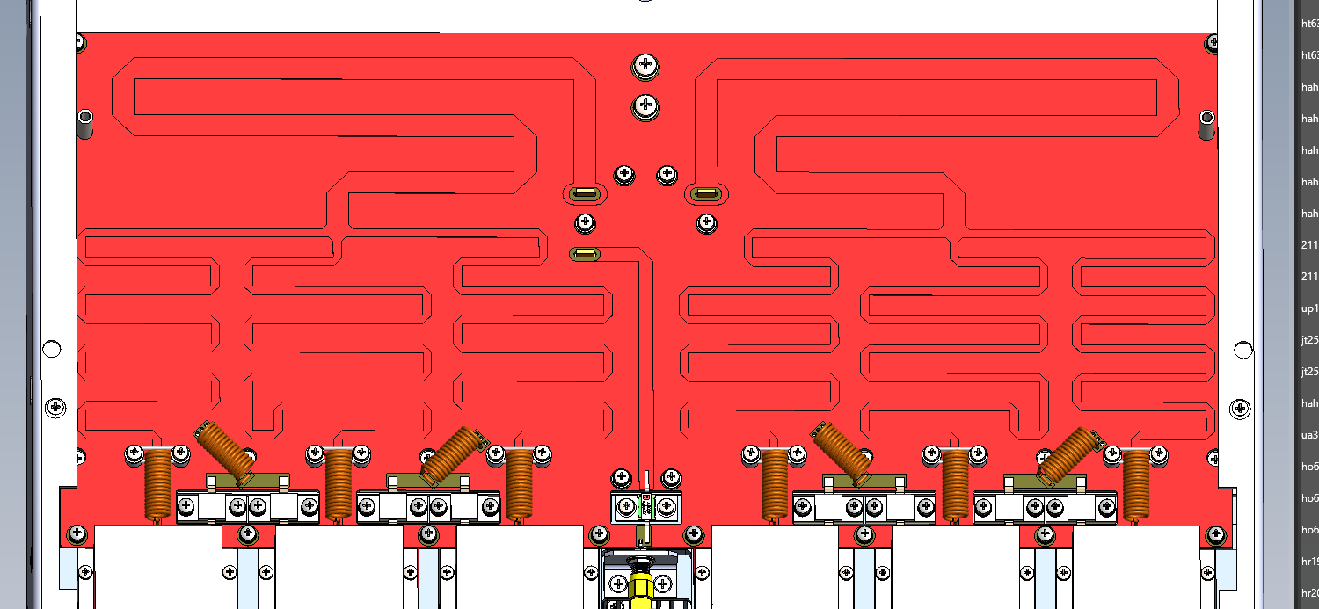
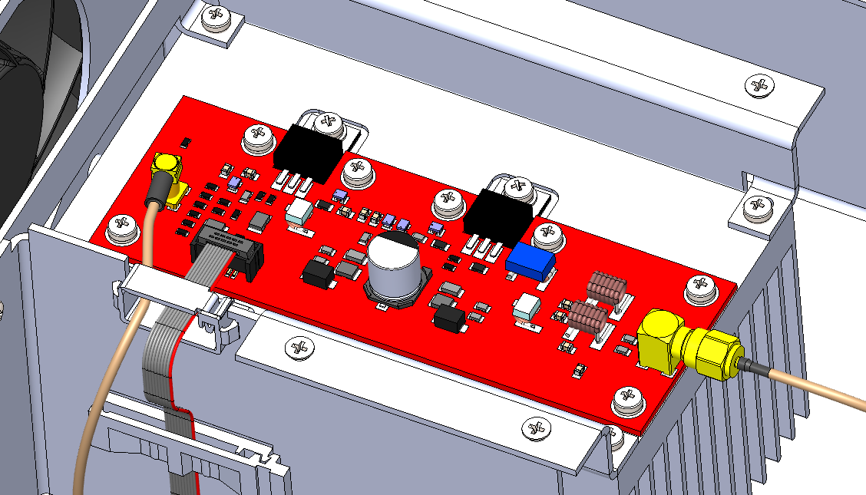
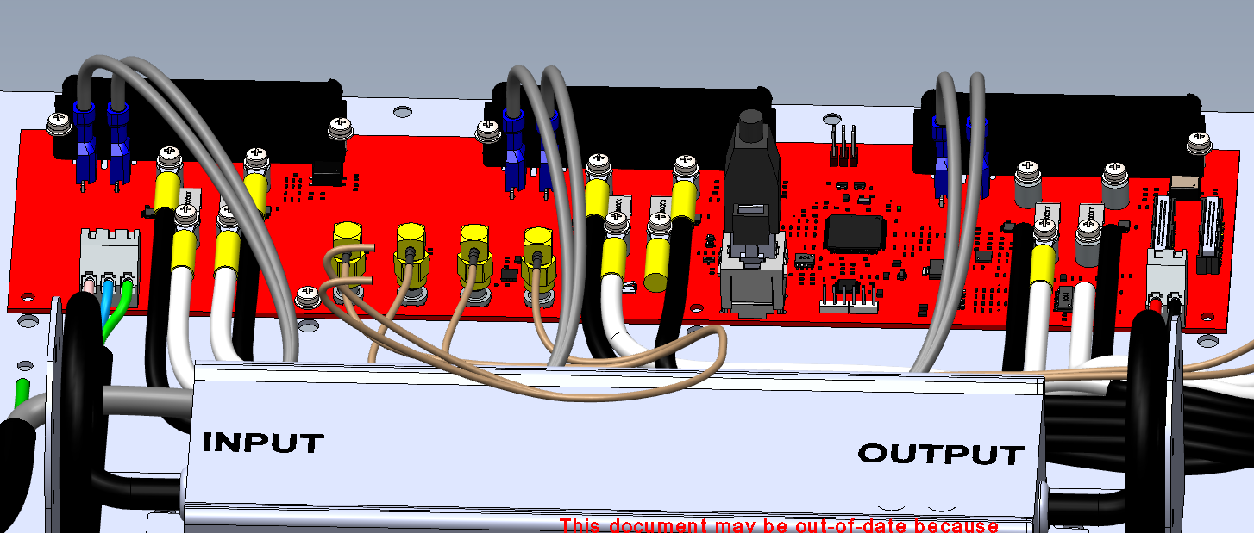
System Components (VX3 to VX6)
6 Way Splitter
Combiner
Power Supply Interface PWB
IPA PWB

Slide 20
SD Card for Persistent Storage
Can be removed to make backups or clone settings (with Transmitter AC off)
Recessed in to avoid accidently removal when working on the system
Easier to replace then having to remove solder-on memory
Provides expandability if new software or firmware features re added that require more storage
WARNING: Can not be removed during transmitter operations or Linux and the AUI will crash
Rear panel accessible
Linux formatted file system
Holds
Operating system
Firmware files
User settings
Minimal onboard Flash memory

Slide 21
Questions and Answer + Hands On
Are there any questions?

