Slide 1
Grounding and Lightning Protection

Slide 2
Ideas for things to discuss
Grounding
  Short and straight
  How much is too much?
New Sites
  Planning ahead
  Staying flexible
Ferrites
  Why Jeff loves them
  How they work when used with other things
Existing Sites
  How to fix them
  What to look for

Slide 3
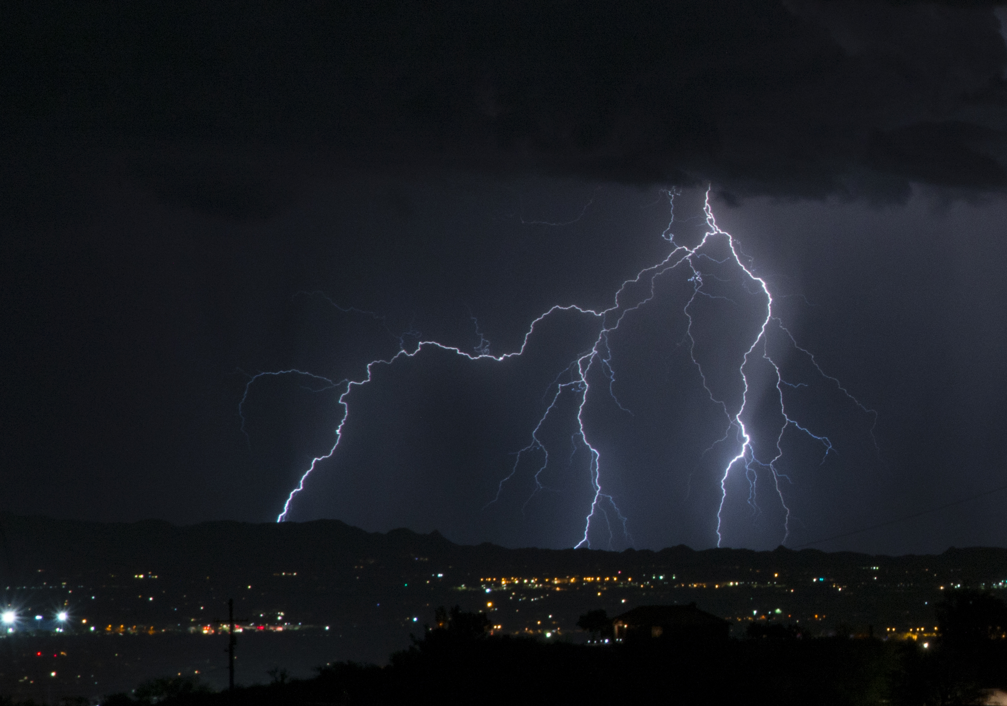
Photo credit: Elaine Jones Associates, www.elainejonespr.com

Slide 4
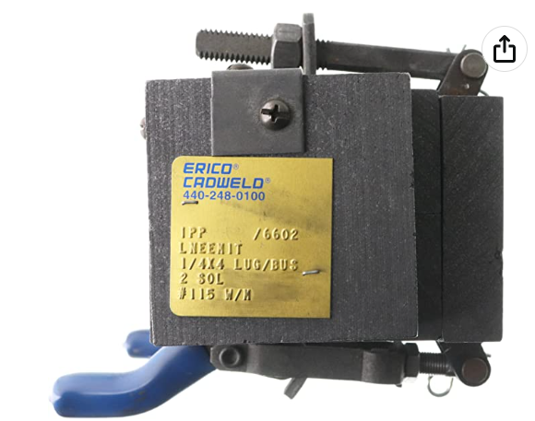
Grounding vs Bonding
Grounding is WHERE you connect the conductors
  Ground rods
  Ground terminals on equipment
  Earth connections
Bonding is HOW you connect the conductors
  Mechanically
    Clamps
    Screws
    Compression connectors
  Exothermically
    Brazed, either bronze or Sil-Fos (silver, copper and phosporous alloy)
    Soldered (whether silver, lead/tin or RoHS compliant)
    Cadweld

Slide 5
Get Well Grounded…
But not too well grounded
  Too many grounds cause issues too.
Single point (star) grounding is the key
  One ground per item, where possible.
  Establish reference ground(s).
  Use a tree, if need be.

Slide 6
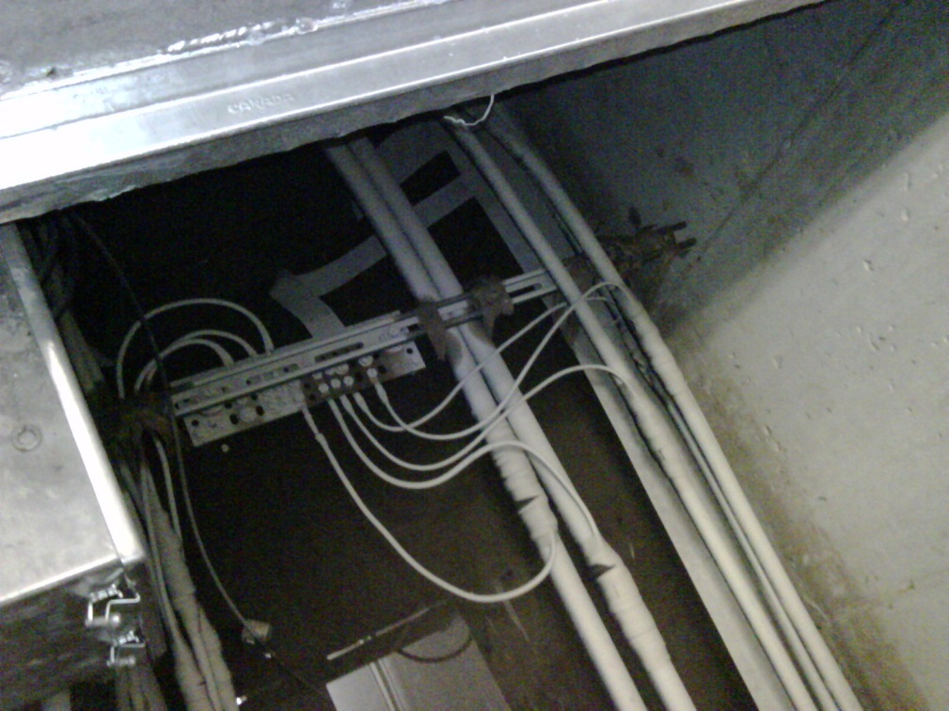
Get Well Grounded…
Single point ground for racks and individual pieces in a room
Keeps all audio shields at a common potential
What’s wrong with this picture?

Slide 7
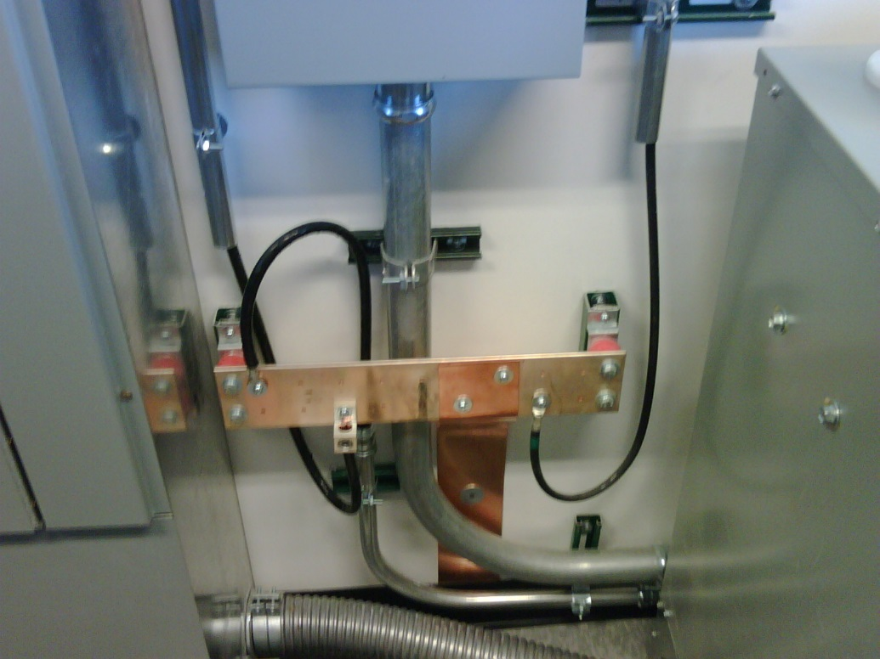
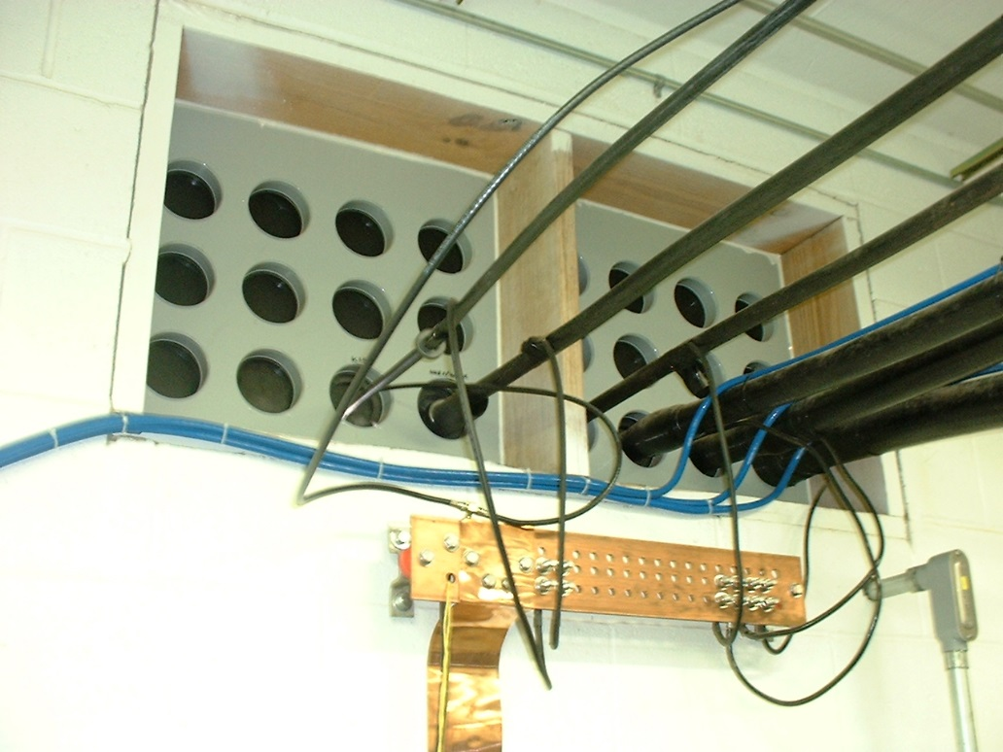
Get Well Grounded…
Buss bar for AC grounds
Tied to station reference ground
All primary equipment connected
Bulkhead ground for coax cables
Best done where cables enter building
Connected to station reference ground
Keep ground leads as short as possible

Slide 8
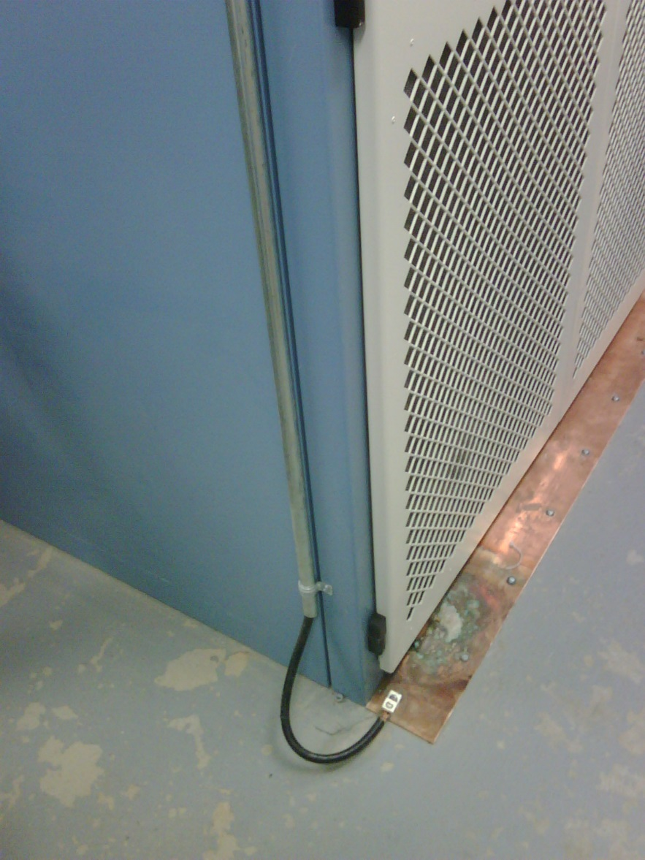
Get Well Grounded…
Equipment Grounding
Note the ground loop?
Avoid attaching conduits to cabinet, except at designated conduit entry points
Black cable shown is an AC safety ground; on a lightning strike, the chassis could become hot.

Slide 9
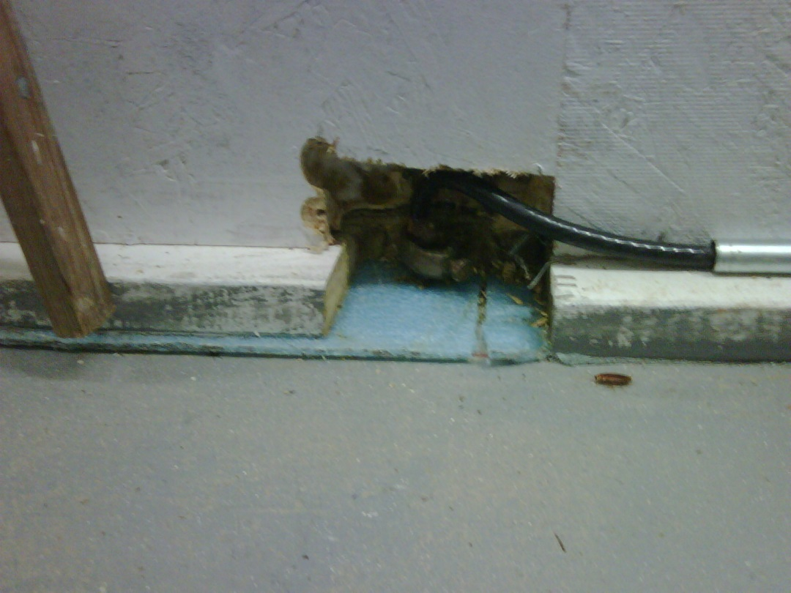
Get Well Grounded…
MAKE SURE YOUR GROUND CONNECTION IS ACTUALLY GROUND!!!

Slide 10
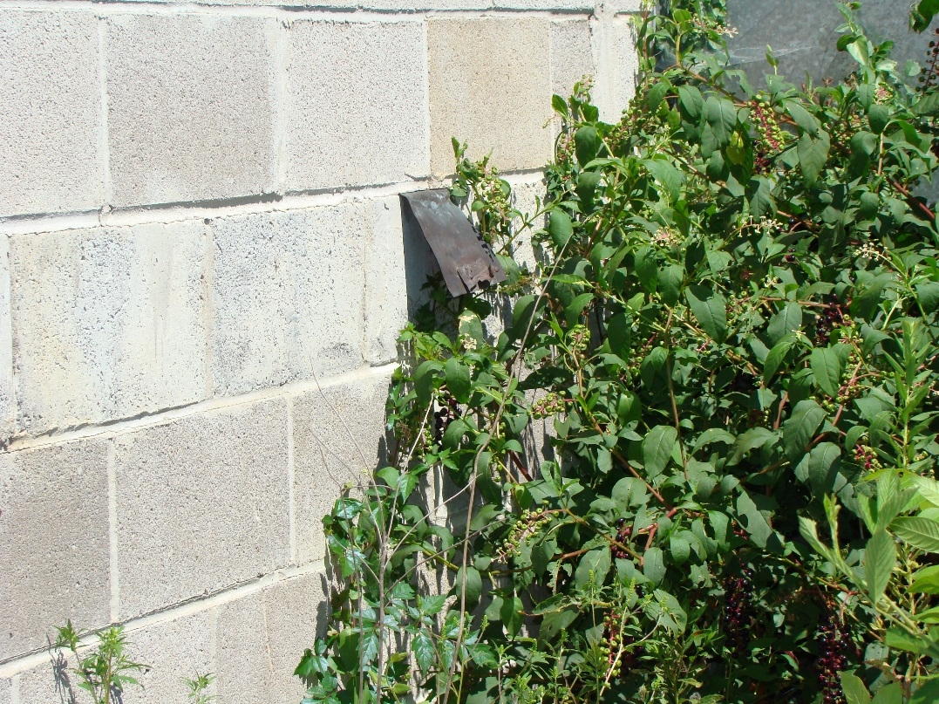
Get Well Grounded…
The best building grounding in the world doesn’t help, if it doesn’t go anywhere when it reaches the outside world!

Slide 11
Ground Rods
Penetrate below the frost line
Moist soil or the water table
Diameter 3/8” or larger
Connected with Cad welded or silver soldered copper straps
Copper or copper clad steel
22 Feet
10 Feet
11 Feet
Electrode Interface Hemisphere
Grounding Conductor
Notes:
NOTES:

Slide 12
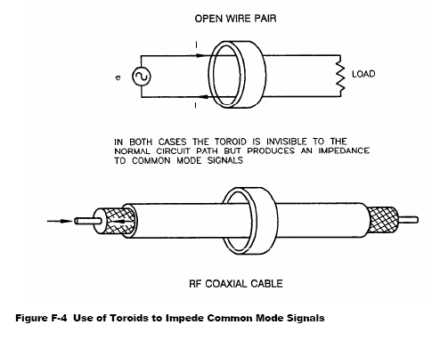
Keep your Shields UP!
Ferrites are good for reducing common mode signals
Lightning surges
Induced RF (especially at co-located AM and FM sites)
Power line and power supply noise

Slide 13
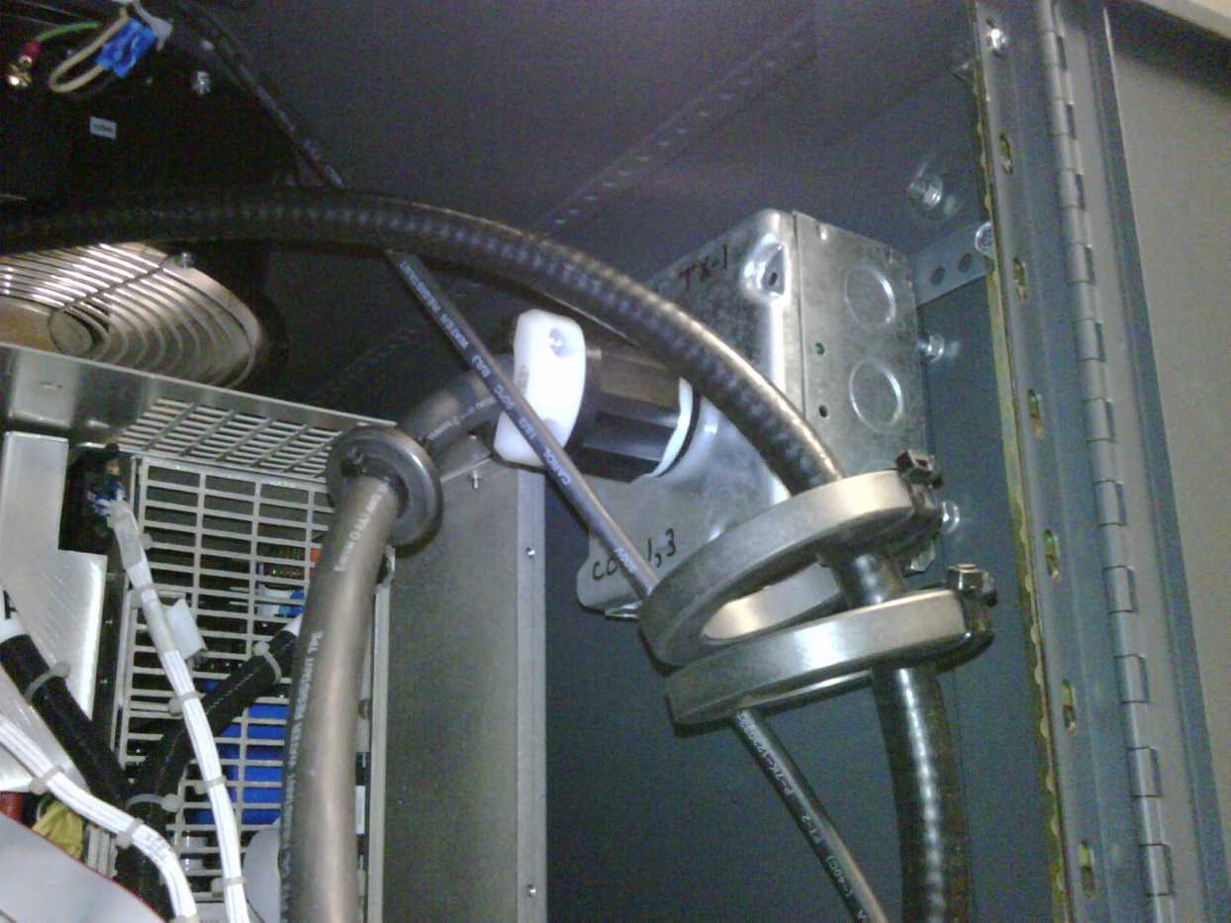
Keep your Shields UP!
Ferrites on AC cabling can protect against surge related power supply damage
All feeds and a ground return through the ferrite
In some cases, such as with purely balanced power supplies, it’s desirable to make chokes (wrap each AC conductor around a separate ferrite). In this case, ferrite composition needs to be considered more carefully.

Slide 14
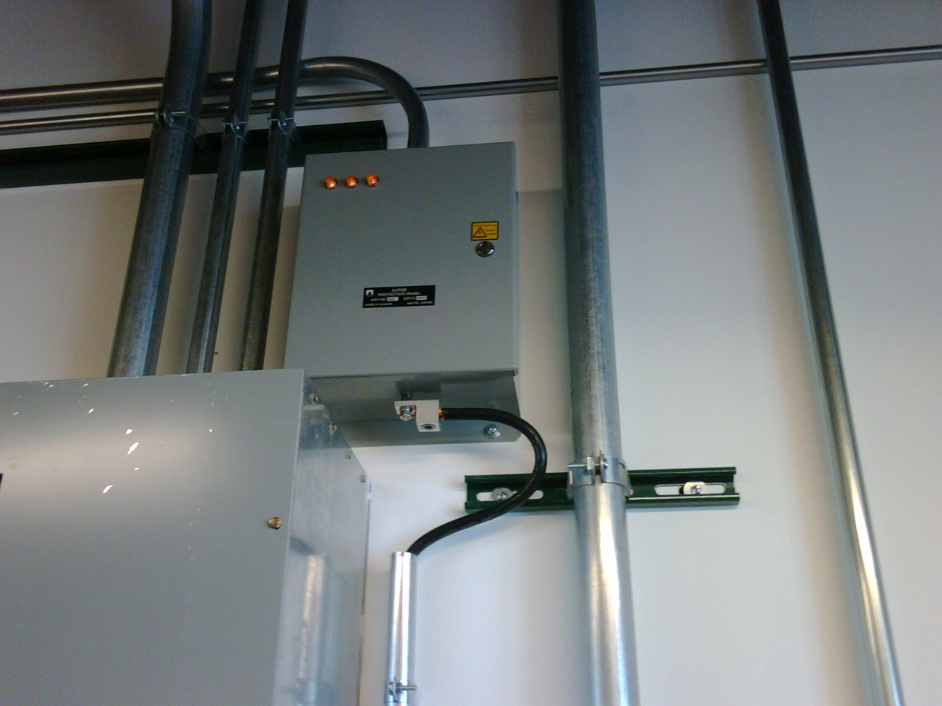
Always Use Protection
AC Power line protectors are a must – and they MUST be connected to your station reference ground.

Slide 15
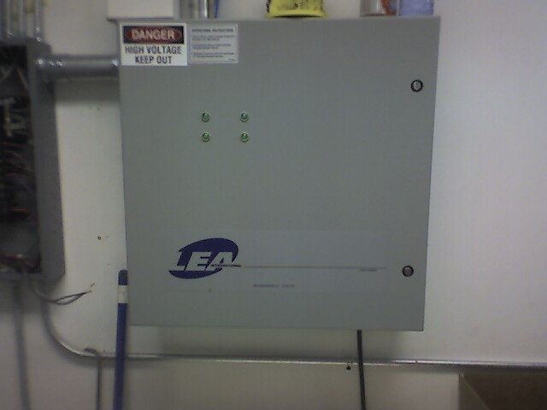
Always Use Protection
As a minimum, a shunt type MOV protector with fused links (and a solid ground connection!!!) is recommended.

Slide 16
Typical Site
Try to have AC, coax, and reference ground enter the building in close proximity
Keep ground straps short
Antenna
Transmitter Building
ATU
Coax
AC Line Supply
Reference Ground Points
Notes:
NOTES:

Slide 17
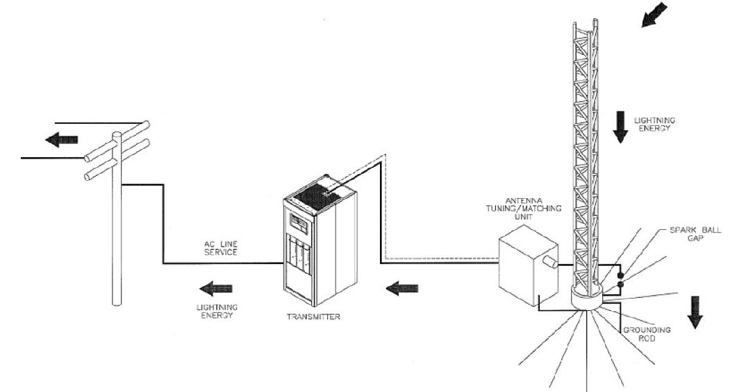
Typical Site

Slide 18
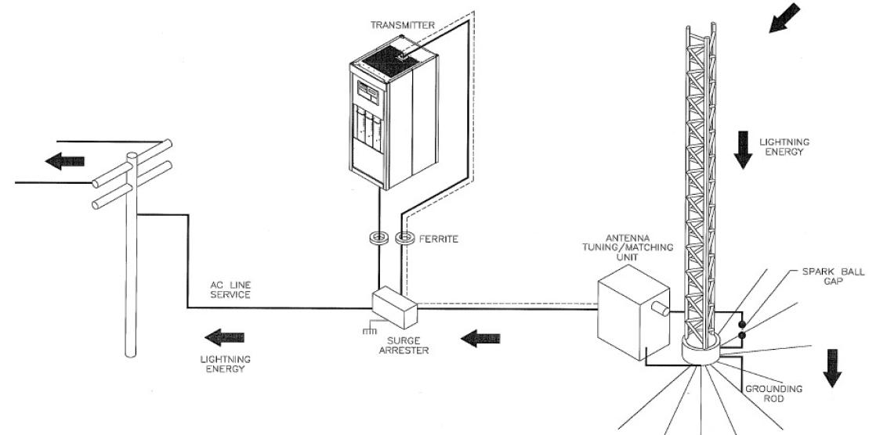
Installation of Surge Protector

Slide 19
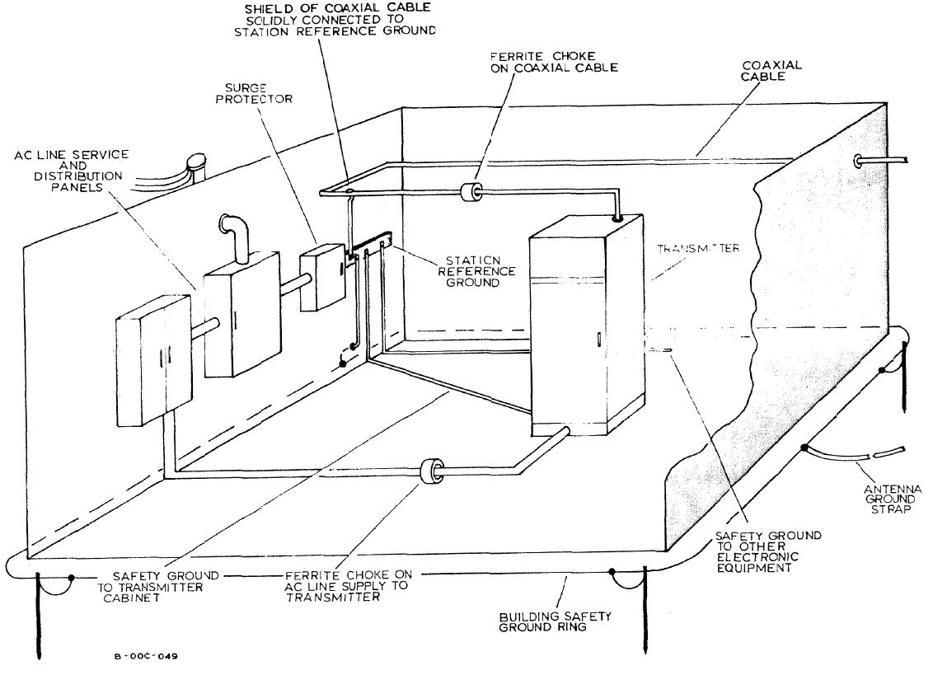
Improving Layout
Notes:
NOTES:

Slide 20
Keep Your Cool
Air handling is very much a cost vs. benefits discussion
These days, computerized equipment, keeping the site (or at least the equipment) cool is more important than ever
In hot, dusty environments, air conditioning is sometimes the only viable solution
In cooler climates, with sufficient incoming air filtration, cooling with outside air can be quite acceptable
  Points to consider:
    Airflow direction (ideally, cooler air will come into the transmitter/equipment intakes, not shooting past it, or coming into the building at the other end).
    Positive pressure – more air should be brought into the building than is exhausted. If the transmitter is ducted, exhaust airflow should be higher than the airflow throughput of the transmitter, with incoming airflow even higher than that.

Slide 21
Cooling and Air Handling
Points to Consider
  If using forced air:
    intake air must be filtered
    draw in more air than is exhausted, to maintain positive pressure
    exhaust more air than the transmitter airflow requirement
    allow for redundancy (use louvres to allow warm air to heat room in cold weather, use multiple blowers to avoid overheating in the event of a failure)
  If using chilled air (air conditioning):
    allow sufficient headroom for building convection (heat from sun, and other equipment in building
    use redundant systems… if you require 5T of air conditioning, consider using two three ton units and alternate the main monthly
    remember maintenance (clean filters and condenser coils as required)

Slide 22
Cooling and Air Handling
AIRFLOW DIRECTION IS CRITICAL!!!
OUT
IN
OUT
IN

Slide 23
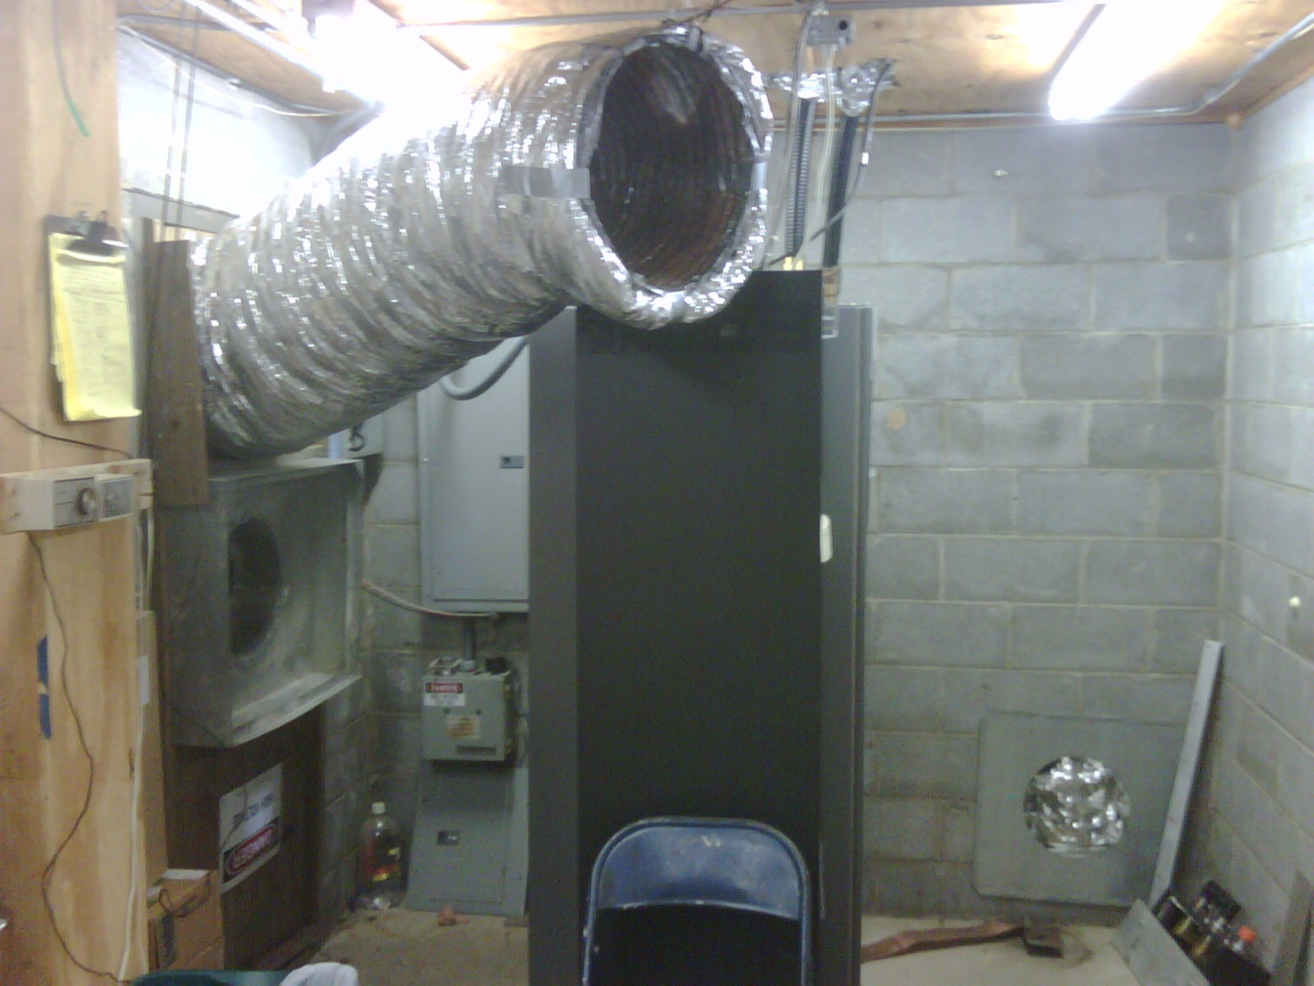
Keep Your Cool
This is an example of poorly considered airflow
The gray rack is the transmitter.
The silver pipe is the incoming air – directed away from the transmitter
The hole below is the exhaust fan – pulling air AWAY from the transmitter air intake (the rear of the transmitter, or left side of the photo)
This site was plagued with PA and power supply failures.
Rerouting the airflow has helped resolve that problem.

Slide 24
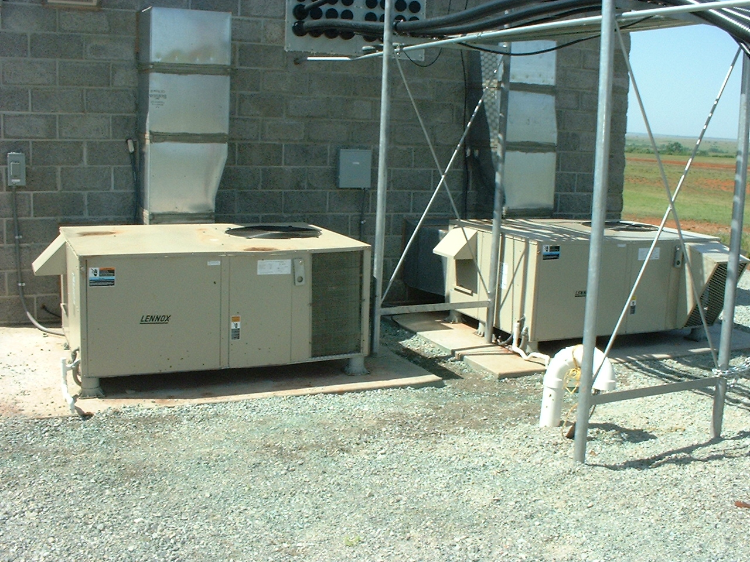
Keep Your Cool
Air Conditioners come in many shapes and sizes (and costs)
Consider redundancy
  Size air conditioners at just under the full building heat load and install two, in a main/alternate configuration
Always take building and environmental heat load into effect. The transmitter, while the primary source of heat, will not be the ONLY source.
Depending on location, security to protect outside units from copper thieves may be required.
Notes:
,0

Slide 25
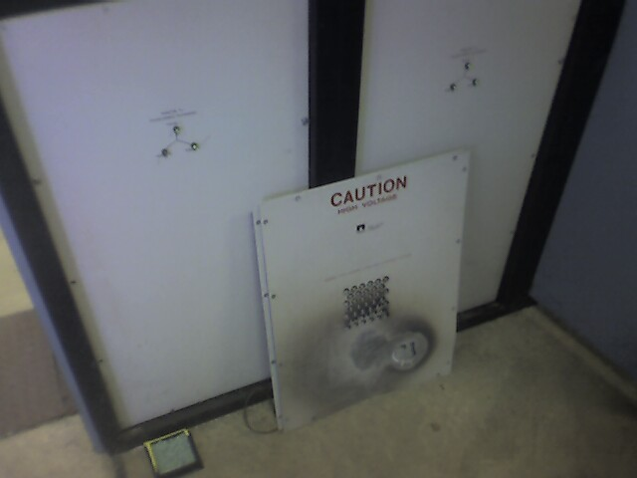
Clean equipment is happy equipment
Poor airflow, or insufficient cooling, can be expensive!!!

Slide 26
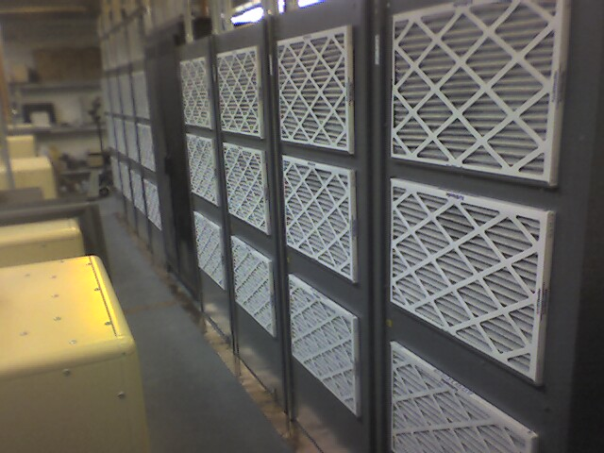
Clean equipment is happy equipment
Air filters – on incoming air and equipment – are there to keep things clean
They must be cleaned or replaced regularly
Equipment should NOT be operated with air filters removed, unless a provisions are in place for additional filtering of incoming air. This is rarely advisable
Do NOT replace air filters with a different type without consulting the equipment manufacturer
Some air fliters require spraying with a sticky substance (FilterKote™) for proper operation

Slide 27
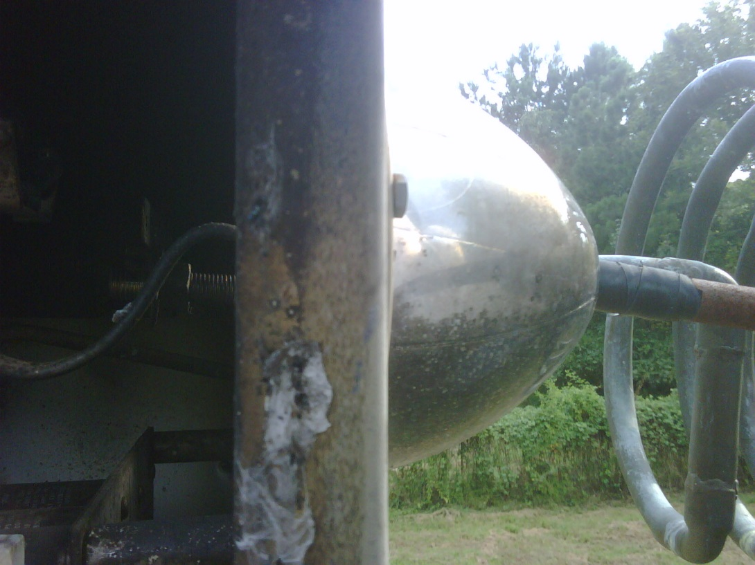
Clean equipment is happy equipment
On an AM site, there are other things that should be cleaned occasionally
- The owner of this 50 kW AM site wondered why the transmitter shut down with VSWR every time the humidity was high

Slide 28
Wrapping it all up…
Keep it grounded
Shield as needed
Move that air
Keep things clean
Be Safe
Protect Yourself – equipment can be replaced

Slide 29
Resources
https://www.fair-rite.com/determining-the-material-of-a-ferrite-core/
https://www.ti.com/lit/ml/slup124/slup124.pdf
https://en.wikipedia.org/wiki/Permeability_(electromagnetism)
https://www.nutsvolts.com/magazine/article/July2015_HamWorkbench
Notes:
NOTES:

Slide 30
THANK YOU!

