Slide 1
Working Alone
Not Recommended, but Sometimes Necessary
CCBE Lunch June 2021
Jeff Welton, CBRE
Regional Sales Manager, Central U.S.

Slide 2
Overview
More companies are having to do more with less
Engineers are getting older
Safety Implications
Legal Implications
Security issues
Personal
Site
IT

Slide 3
Graying Talent
What does it mean?
In the 10 year period between 2001 and 2011, the average age of broadcast engineers as a group rose by 4 years.
If this continues, very shortly, there will be a shortage of engineering personnel, as older engineers retire.
In addition, unless there is a significant upswing in mentoring, essential skills will be lost – the ability to work on equipment with HV sections and tune in an AM array, to name two.

Slide 4
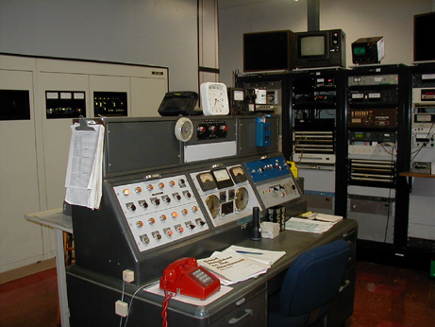
Lower Budgets
Fifty – or even 25 – years ago, manned transmitter sites were quite common and engineering staff tended to include both RF and audio engineers.
Photo of WCCO transmitter control point, © www.oldradio.com – originally taken by M. Durenberger

Slide 5
More Reliable Equipment
The advent of solid state electronics has permitted redundancy resulting in fewer off-air type situations.
Modular construction permits repairs to be carried out while on air, during daytime hours.
Lower operating voltages tend to make equipment safer to work on – in general.

Slide 6
More IT, less RF
More and more, equipment is microprocessor based and networked, requiring specialized skills traditionally not part of radio station engineering.
As a result, in many cases, the bulk of repairs and upgrades can be carried out by personnel with IT skills.
However, it’s still high voltage RF going to the antenna and frequently high voltage AC/DC in the power supplies.
Notes:
More and more, employees are being tasked with multiple responsibilities. With the prevalence of IT based equipment, frequently a new replacement for a retiring engineer will be selected based more on their computer skills than their RF and component level troubleshooting abilities.

Slide 7
Nothing Ever Breaks
With higher levels of redundancy, equipment can frequently stay on air in spite of failures.
This frequently gets interpreted as “no failures”, since there were no interruptions to the broadcast.
In spite of this, the need for ability to troubleshoot, work a soldering iron and perform complex repairs is still an important part of the job. Perhaps more important as these skills are typically only needed in urgent situations where a simple board swap won’t solve the underlying problem.

Slide 8
Why Nothing Ever Breaks
As a rule, the sites with the fewest actual failures tend to be the ones where the work is put into protection and maintenance, rather than “putting out fires”.
More and more, in today’s reality, less time is available for maintenance – although there always seems to be time for the “fires”…

Slide 9
“Other Duties, As Required”
This frequently leads to a misconception that engineers can be less skilled, since they’re frequently doing maintenance tasks – cleaning filters, improving grounding, performing “check-ups” rather than actual repairs.
In the ideal world, maintenance tasks should take up the vast majority of the engineer’s time. If this were the case, the amount of repairs required would decrease dramatically.

Slide 10
Resulting Safety Concerns
Mark Persons, “Where Have All the Engineers Gone?”, Radio World, 16 May 2012
More and more, the person tasked in maintaining the station may have a solid IT background, but have much less training and experience related to dealing with high voltage situations.
Power Supplies
Tube cavities
RF Filters, Phasors, Antenna Tuning Networks

Slide 11
Resulting Safety Concerns
More frequently, engineers are working alone, often after a full day at another job, bringing fatigue into the equation.

Slide 12
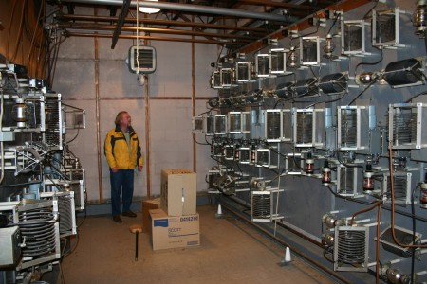
Photo of WISN phasor © www.oldradio.com

Slide 13
29CFR1910 says:

Slide 14
Costs of Fewer Engineers
Beyond the legal costs associated with a tragedy, the decline in available engineers comes with several other potential costs:
Cost of off-air time due to failures
Can tend to be higher as a result of lack of maintenance
Cost of repairs
Time and materials for in-house repair
Higher costs for factory repair/exchange… if available.
Increased time to repair failures by inexperienced personnel, with attendant risk of additional failures due to fatigue or misdiagnosis.

Slide 15
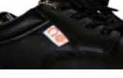
Proper Protection is Important
ESR (EH in the U.S.) rated footwear can keep you alive if you come in contact with a live circuit.

Slide 16
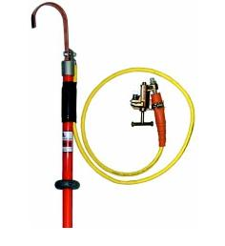
Ensure everything is discharged
A ground stick can scare the pants off you if it hits a live circuit… but not nearly as badly as if YOU had hit that circuit.

Slide 17
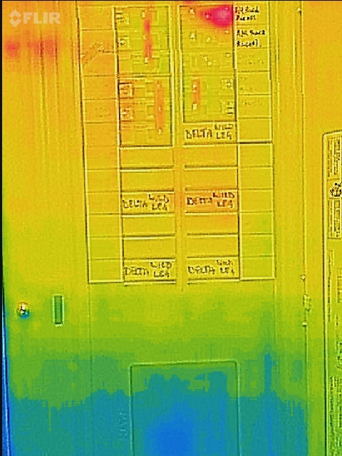
Thermal Scans

Slide 18
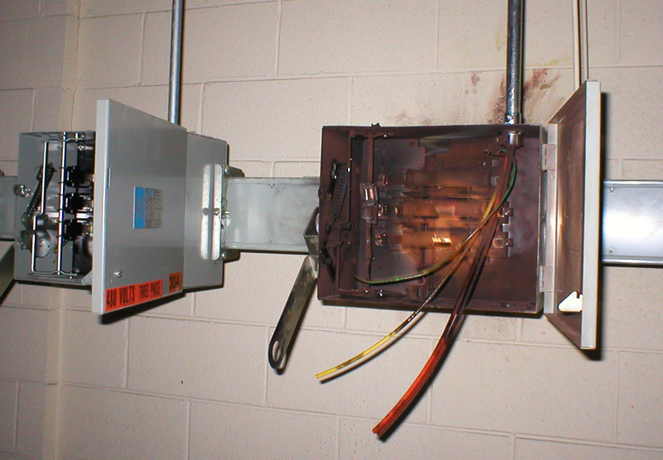
Safety is Key
Arc Flash
Can happen on any circuit handling over 125kVA
50kW AM on 240VAC
Any AM transmitter 100kW or higher
40kW FM on 240VAC

Slide 19
Safety is Key
Lockout/tagout – it can save your life

Slide 20
Safety Considerations
Locking out a breaker while working on equipment ensures nobody else will be turning it on… while you’re still in the rig.
Transmitter interlocks are a safety feature, not an inconvenience to be bypassed and left bypassed.
Measure before touching! Some systems have multiple AC mains connections (such as separate feeds for exciters).
De-energize everything – breakers off, then ground stick.
Airflow interlocks protect equipment

Slide 21
Safety is Key
Even after you’ve locked out the power source, a fast verification is a good idea (breakers can weld closed)

Slide 22
Let’s Be Careful Out There
There is always the “potential” for danger.
AC mains can be up to 600VAC… always measure any AC connection with a known working voltmeter before touching – use an appropriate meter.
RF connections, especially in AM plants, can carry thousands of volts… use a grounding stick, or fashion one out of a set of jumper cables and a wooden broomstick… NEVER ASSUME THAT IT ISN’T HOT!!!
A 300 foot insulated tower can pick up hundreds of volts of static on a windy day, even when disconnected from the transmitter.
It can also pick up hundreds of volts of RF from another station.
Messenger cables on long horizontal coax runs can be great antennas – and carry enough voltage to cause a very painful burn.
Be careful of transmitters which may have bypassed interlocks or “modified” protection circuitry.
Electrical circuits, especially high current DC supplies, have a lot of storage capacity to counteract mains sags. These can be hot for a long while after mains power is removed.

Slide 23
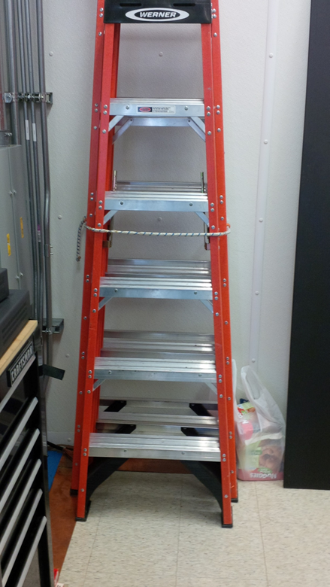
Ensure use of proper safety equipment is mandatory
Ladders rated for working with electricity (and make sure ladders are used, don’t stand on chairs!)
Equipment should be secured when not in use.

Slide 24
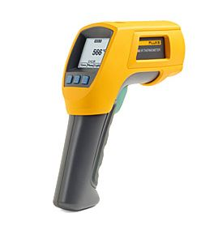
Troubleshooting/Maintenance
All legacy equipment (anything over 15 yrs old):
Check power supply wiring for cracked insulation
Check circuit breakers for mechanical integrity and operating temperature.

Slide 25
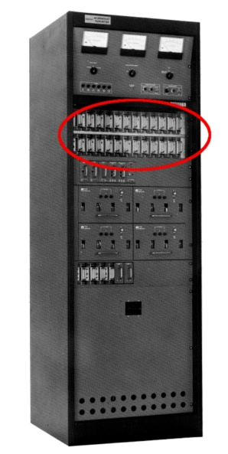
Troubleshooting/Maintenance
If a transmitter has a cover panel, LEAVE IT IN PLACE!
Safety
Airflow
Circulating currents
Unless there is a note specifying it’s to be removed!

Slide 26
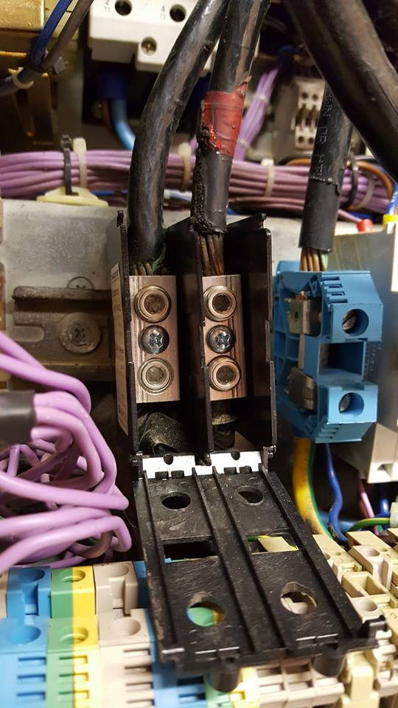
Hardware
Compression connections must be checked periodically

Slide 27
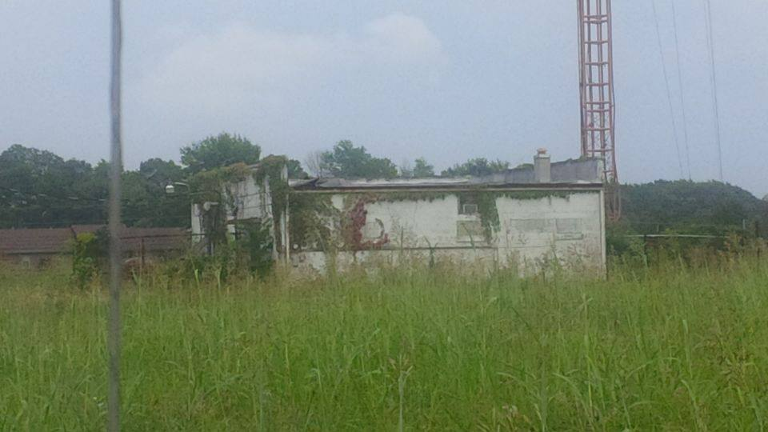
Security – it protects you and stuff

Slide 28
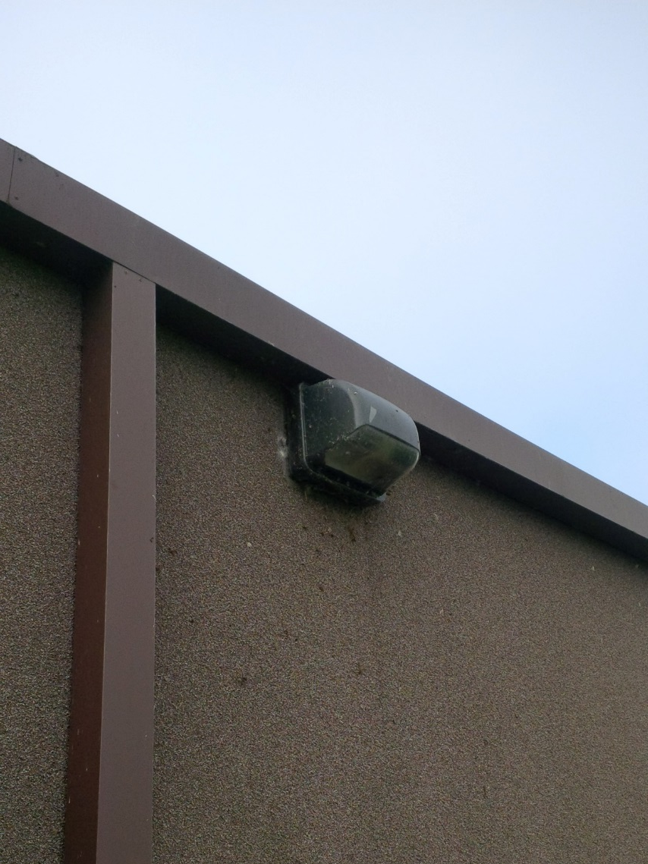
Security – it protects you and stuff
Floodlights are relatively cheap
A well lit site is less likely to be robbed or vandalized.

Slide 29
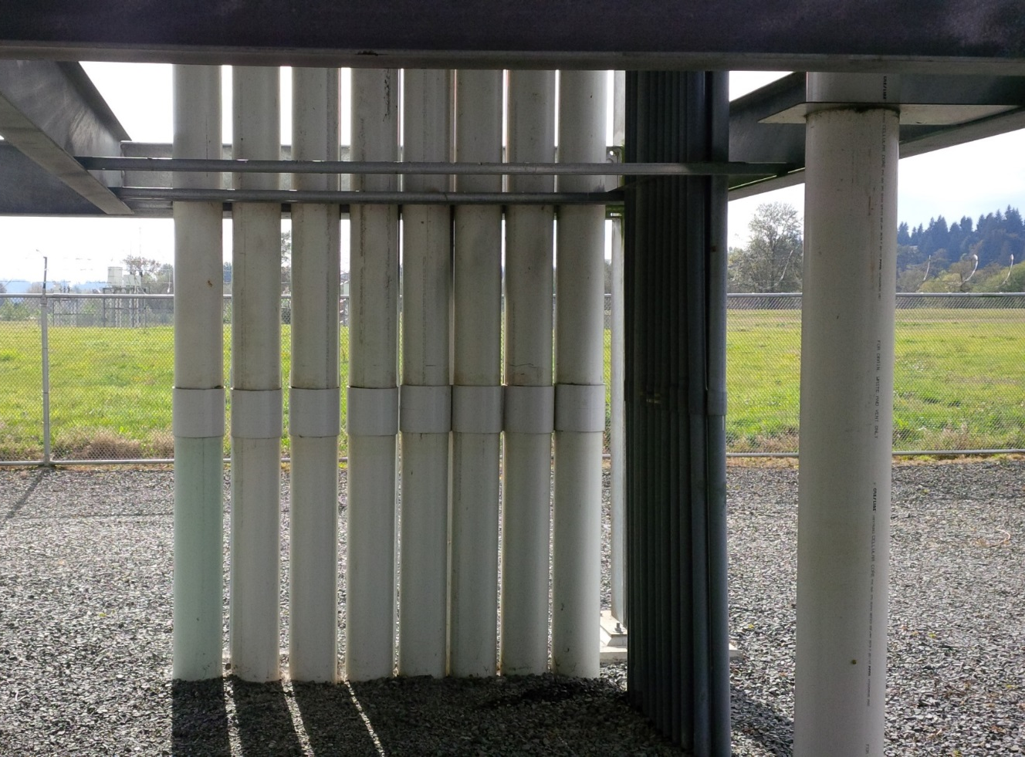
Security – it protects you and stuff
There are two ways to prevent copper theft…
Bury it.
Make it less valuable or make it appear so.

Slide 30
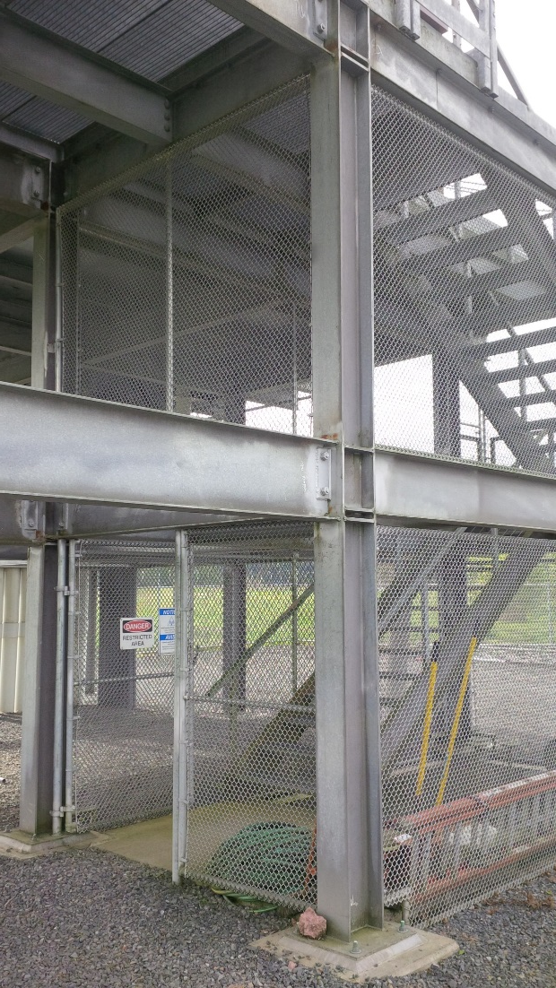
Security – it protects you and stuff
A well secured entrance creates peace of mind.
If vandals or thieves can’t get to your front door, it makes their task harder.

Slide 31
Security – it protects you and stuff
Use good quality locks and entrance hardware
Keyed alike is helpful
Security locks for which keys are registered (and can’t easily be copied).

Slide 32
Security – it protects you and stuff
A high quality peephole lets you see who’s at the door.
It’s also harder to shoot through!

Slide 33
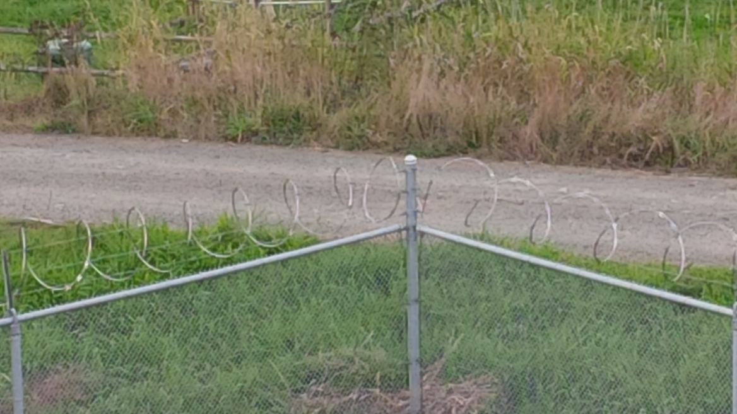
Security – it protects you and stuff
Obviously, a well fenced area is harder to get into!

Slide 34
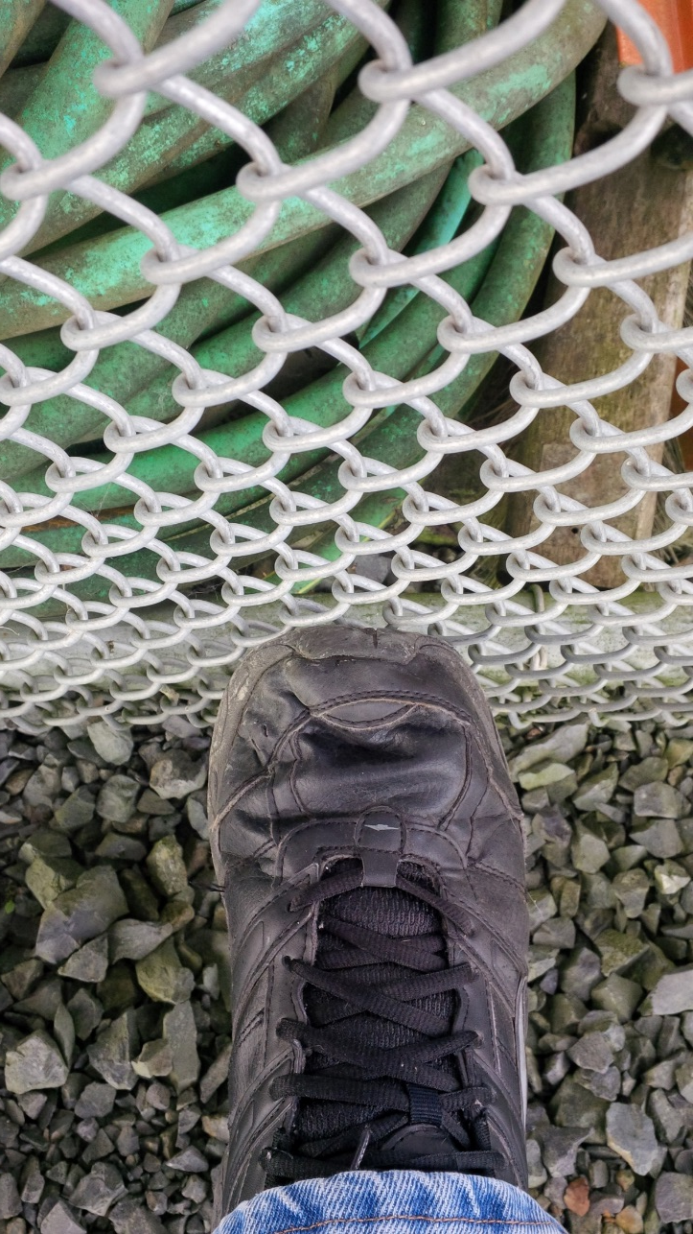
Security – it protects you and stuff
Anti-climb fencing can also be useful
It also takes a lot longer to cut through

Slide 35
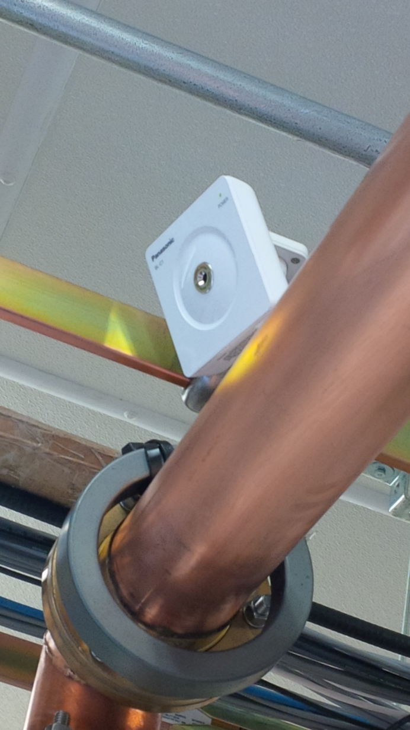
Security – it protects you and stuff
Web accessible cameras are cheap.
They won’t prevent break-ins or theft, but they can provide a record.
In connection with motion sensors tied into the remote control, they can provide a way to see what’s going on and provide faster police response. This can help limit damage and loss.

Slide 36
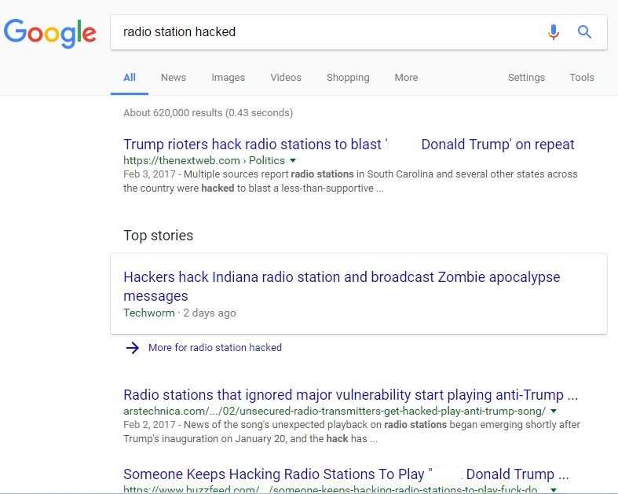
IT Security

Slide 37
IT Security

Slide 38
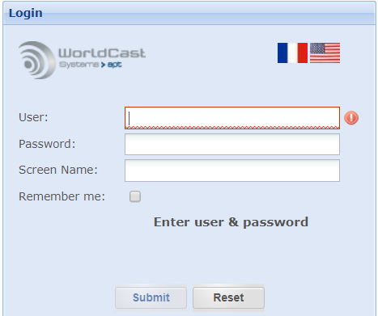
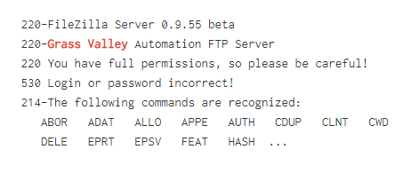
IT Security

Slide 39
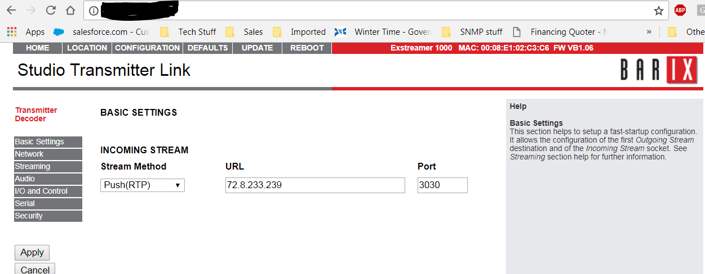
IT Security

Slide 40
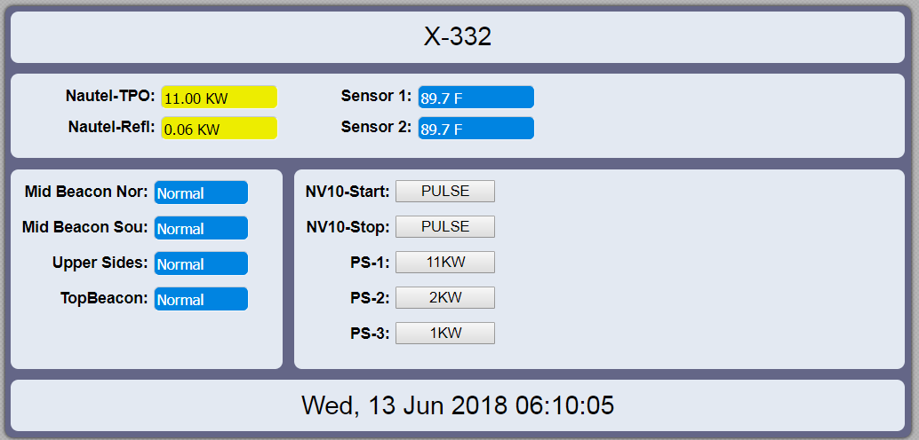
IT Security

Slide 41
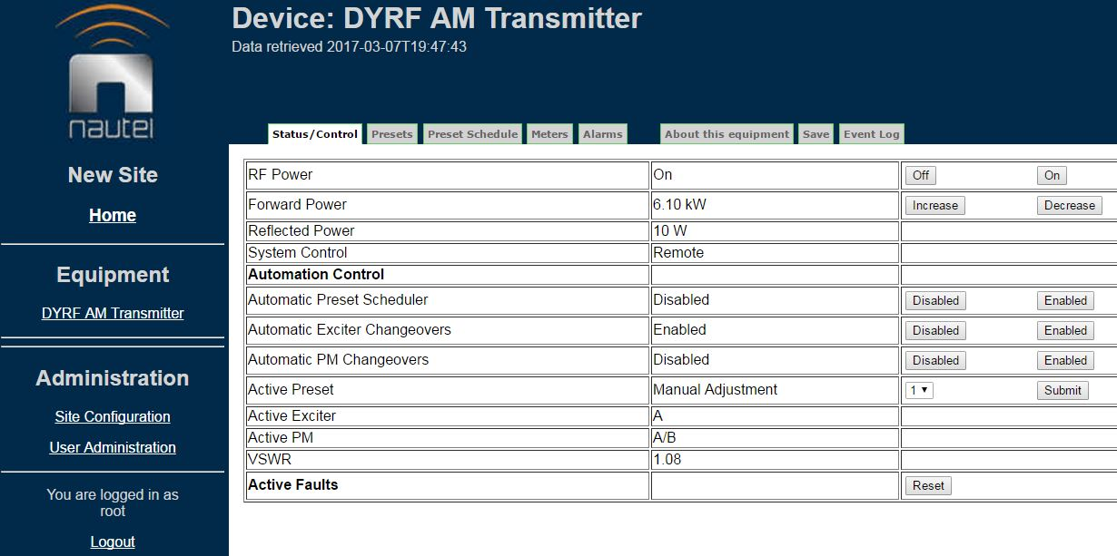
IT Security

Slide 42
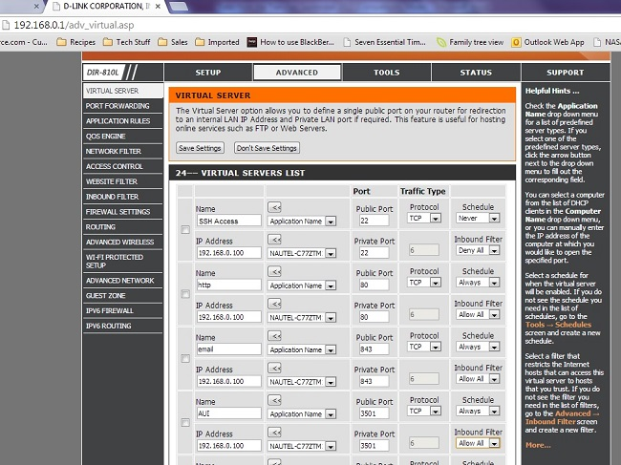
IT Security

Slide 43
IT Security
In Summary:
Use a firewall, block any ports that aren’t essential to operation.
CHANGE DEFAULT USERNAME / PASSWORD!!!
For critical devices (most of them) consider a VPN – or put them all on a non-internet connected local network, then use a VPN to access it.
Alternately, use a product such as TeamViewer to access.

Slide 44
To review:
We are all doing more with less
Fewer resources
Lower budgets
Shrinking talent pool
We need to carefully manage to ensure we’re not overlooking critical points
Safety
Maintenance vs. “firefighting”
Potential legal implications
Protection of license
Avoiding liability

Slide 45
Learn More / Stay in touch
Nautel Waves Newsletter https://www.nautel.com/newsletters/
Webinars https://www.nautel.com/resources/webinars/
YouTube https://www.youtube.com/user/NautelLtd

Slide 46
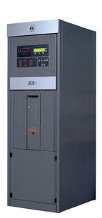
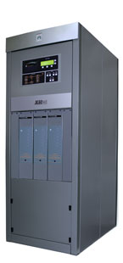
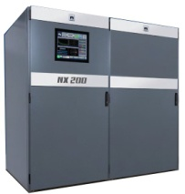
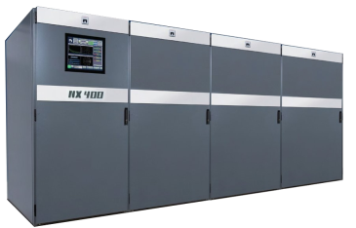
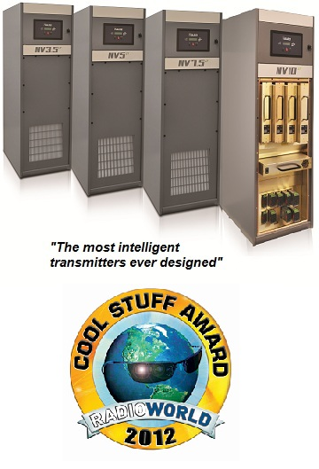
Nautel Major Product Families
NX Series AM transmitters
3kW – 2.0MW
NX3
NX5
NX10
NX25
NX50
NX100
NX200
NX300
NX400
GVSeries FM
VSSeries FM
3.5kW – 88kW
300W – 2.5kW
Advanced User Interface (AUI)
NVLTSeries FM
3.5kW – 88kW
Now all Nautel transmitters are shipped with a
FOUR YEAR WARRANTY!
Notes:
The numbers next to the transmitters indicate wattage, so XR3 = 3000 watts
On NavAids it is different, typically it is 4x power

Slide 47
Thank You

