Slide 1
Rack-Mount Analog FM Tx

Slide 2
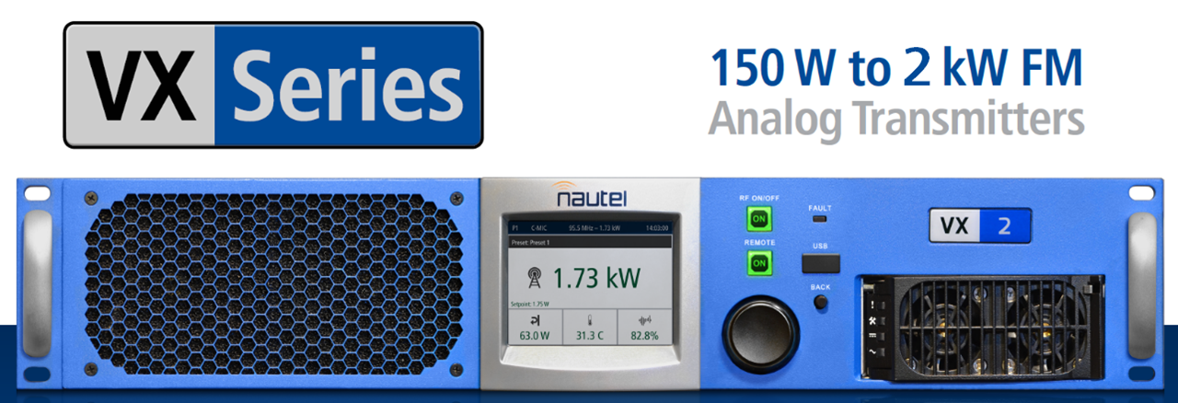
The new VX Series… Compact, Efficient, Affordable
6
Notes:
Still need to fix the Forward Power and Setpoint to match
Reflected Power is still way too high

Slide 3
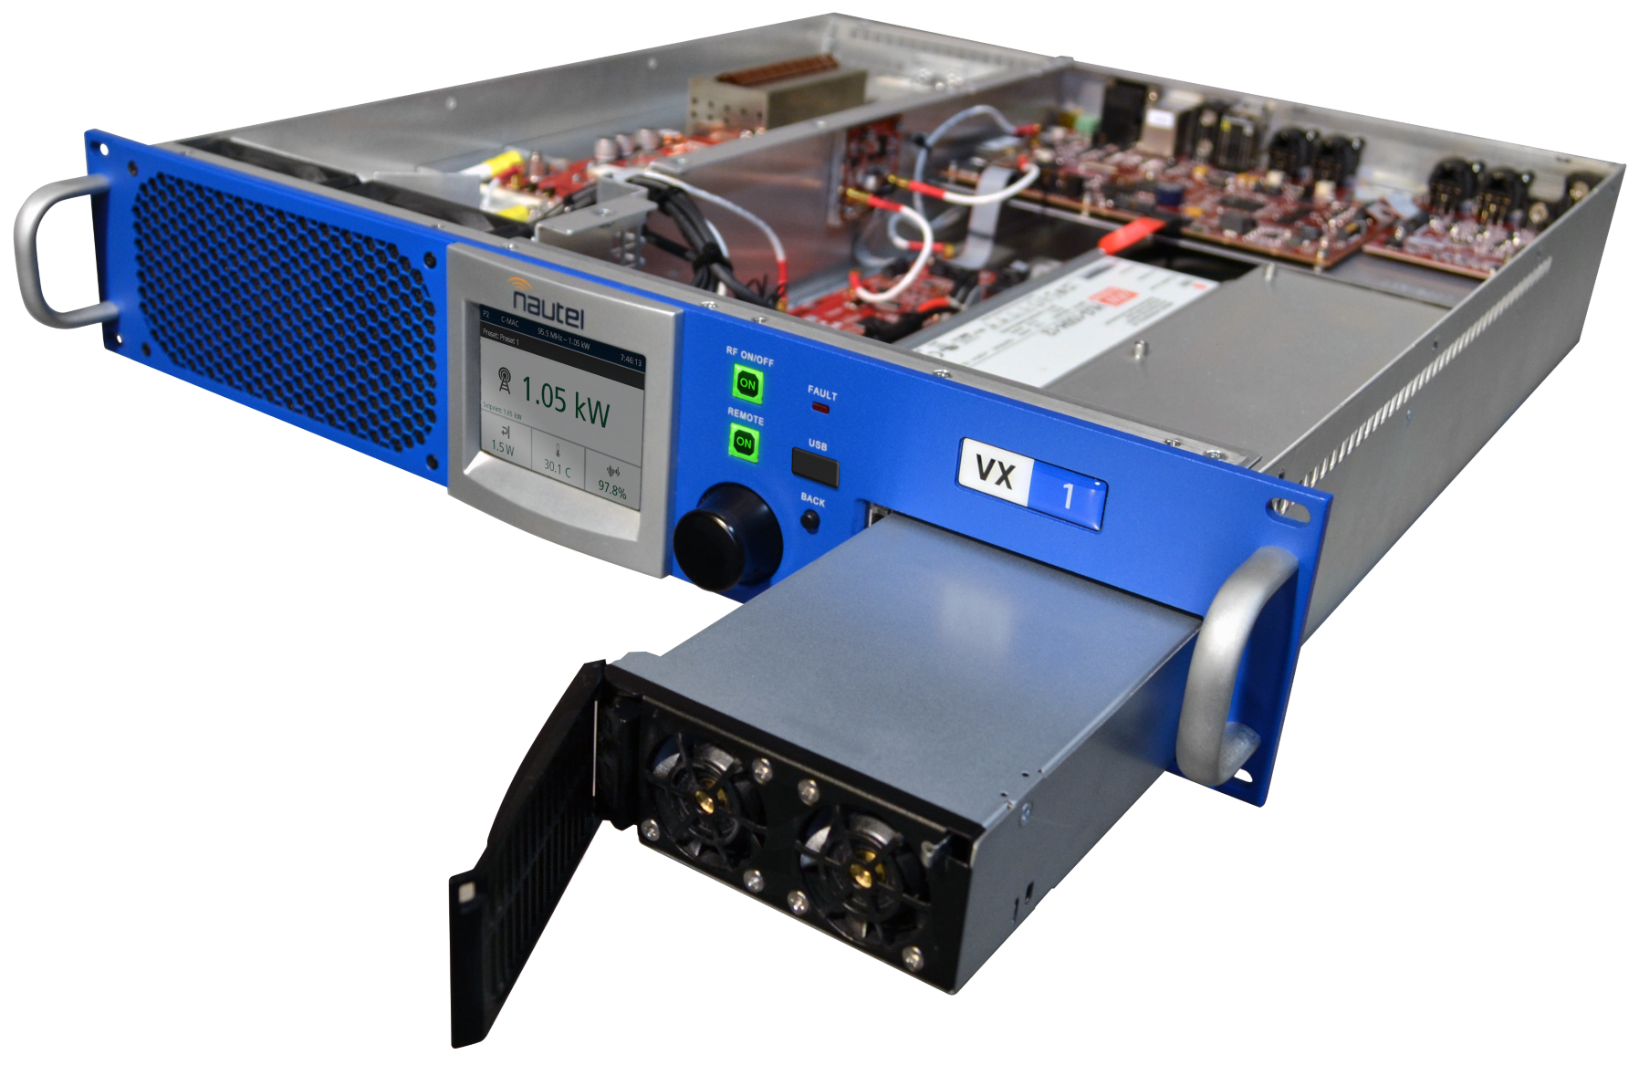
NEW VX Series:
Easy Service
Ground-up new design
Power Chain
Modern Exciter
Advanced RF
Control & UI
More Affordable
Long-Life Design

Slide 4
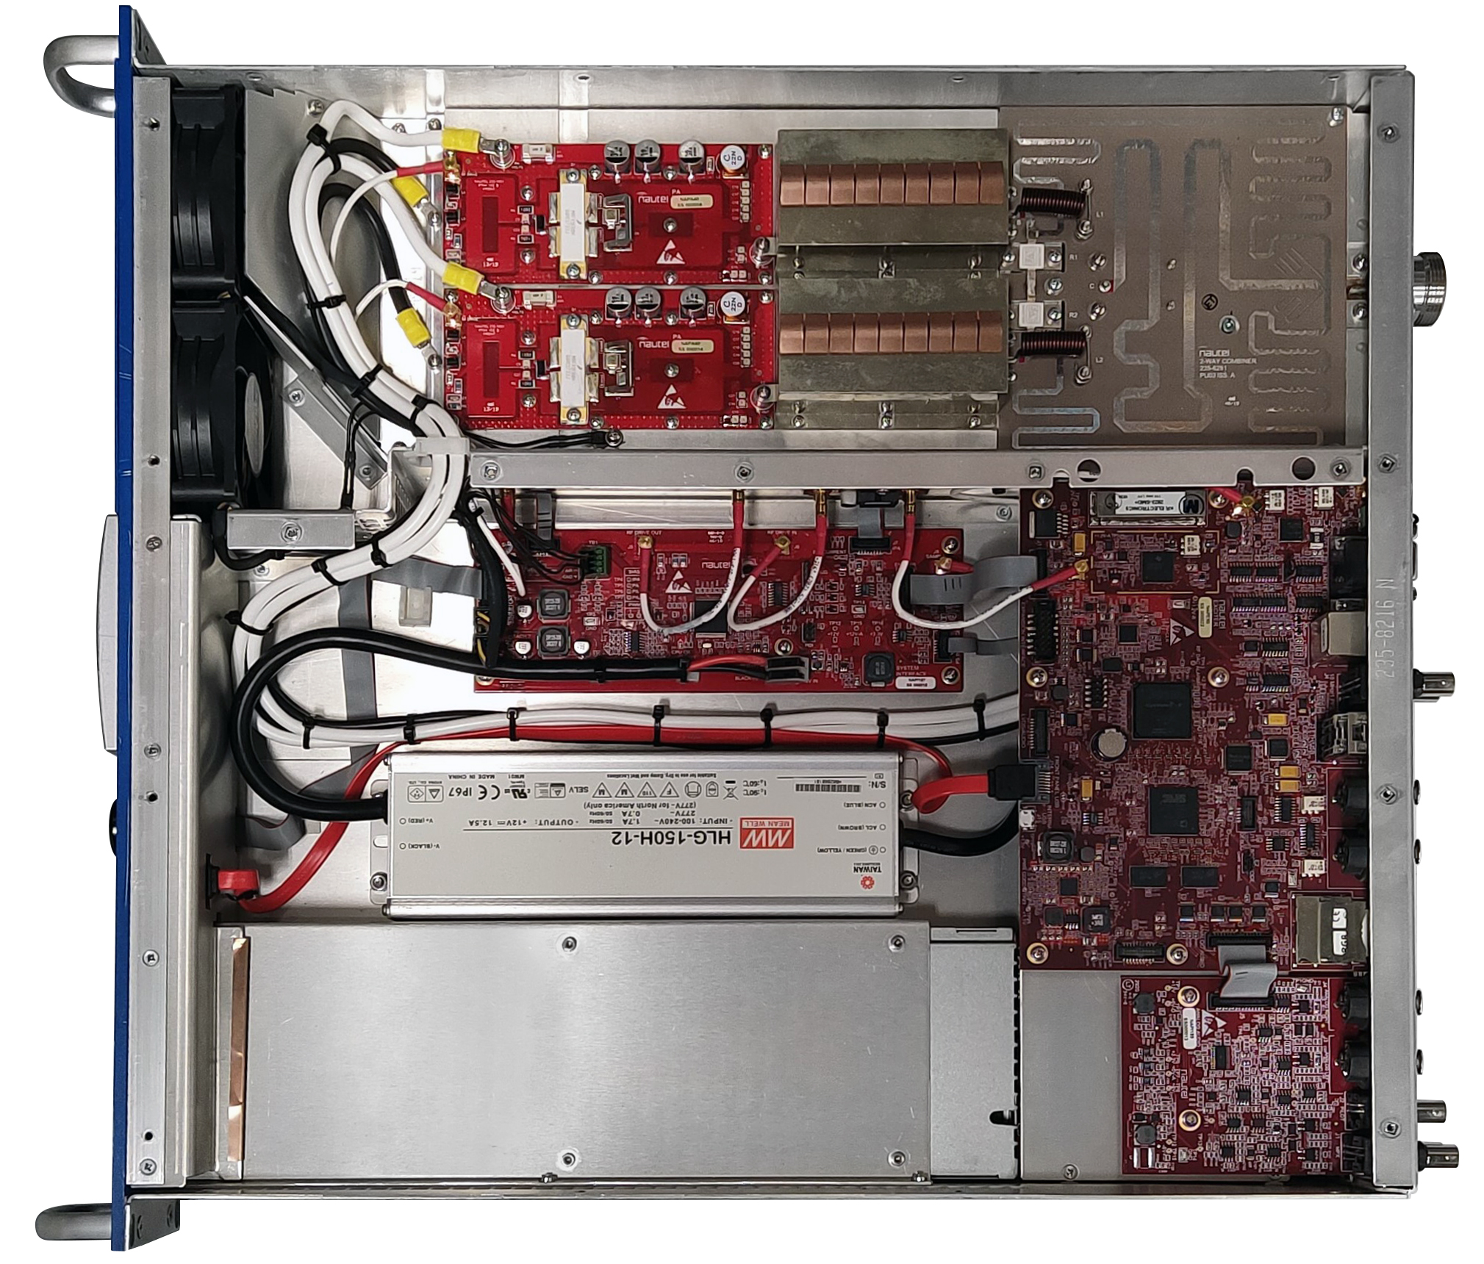
NEW VX Series: Technology tour
Easy Service
Clean accessible layout
Easy Service
Power Chain
Modern Exciter
Advanced RF
Control & UI
More Affordable
Long-Life Design

Slide 5
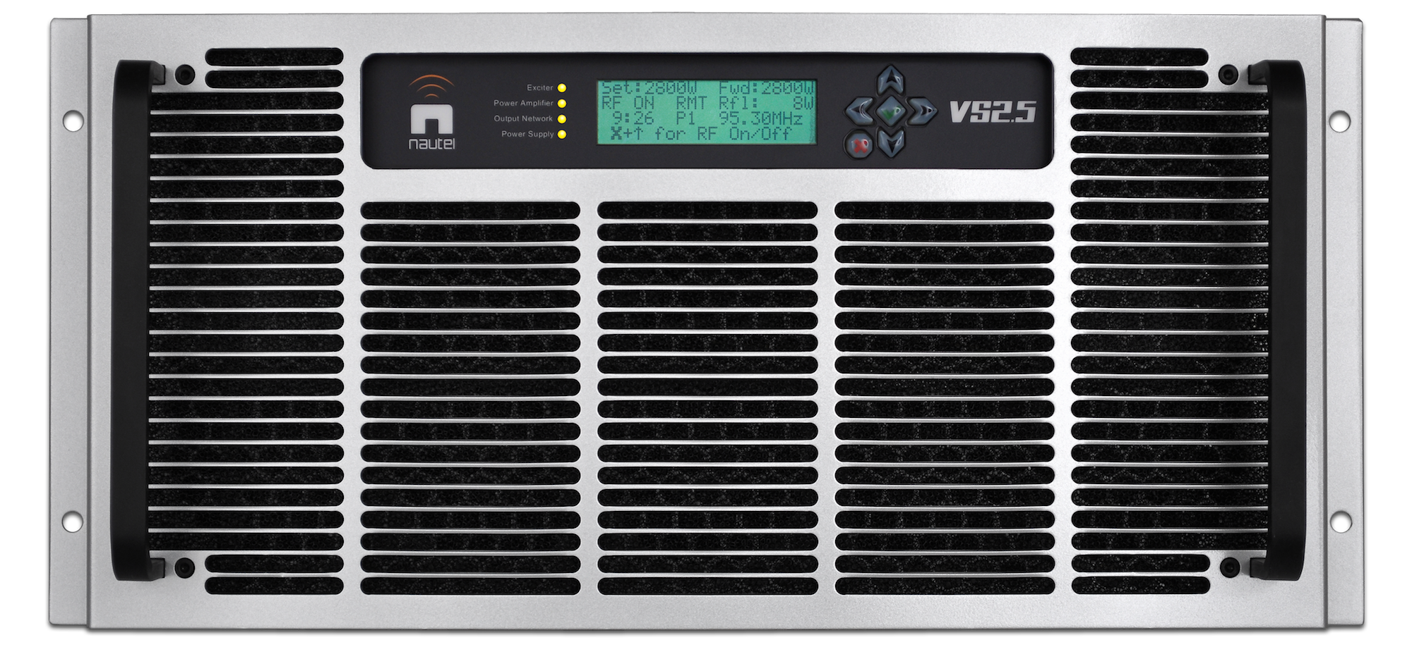
NEW VX Series: Technology tour
Easy Service
Weight
Easy Service
VS2.5
65 lb
Power Chain
VX2
24 lb
Modern Exciter
Volume
VS2.5
2.34 ft³
Advanced RF
VX2
0.71 ft³
Control & UI
More Affordable
VS2.5
Long-Life Design
VX2

Slide 6
NEW VX Series: Technology tour
Easy Service
Efficient Power
Power Chain
Modern Exciter
Advanced RF
Variable voltage PS
Efficiency implications
Control & UI
More Affordable
Titanium grade
power supply
96% efficiency
Long-Life Design
Fingertip access

Slide 7
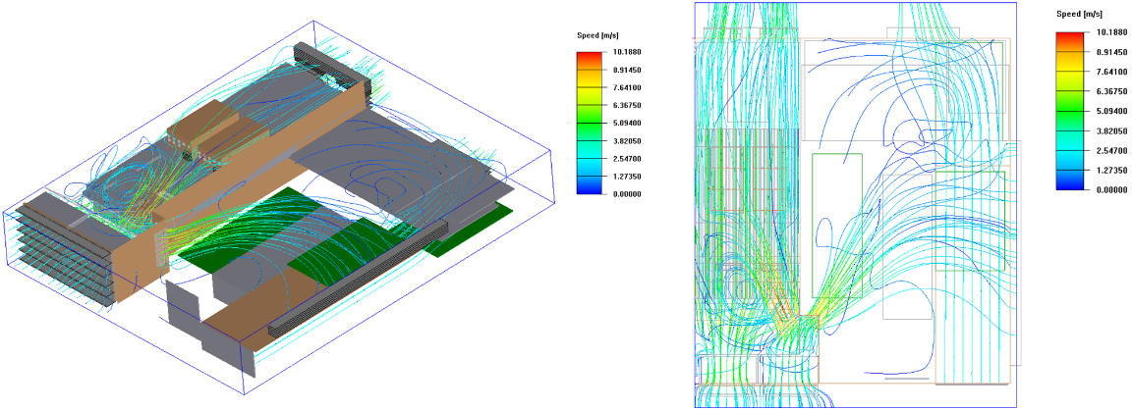
VX2 CFD Modeling
NEW VX Series: Technology tour
Easy Service
Rigorous design & device selection:
Efficient Power
Exhaustive thermal design:
Cool air over fans extends bearing life
Utilize variable speed, long-service-life fans
250 million hour FET MTTF (electromigration)
Modern Exciter
Advanced RF
Control & UI
Affordable
Long-Life Design
Long-Life Design

Slide 8
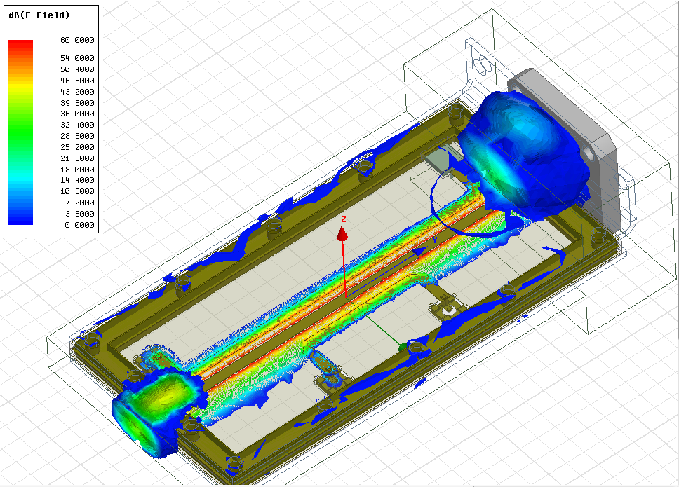
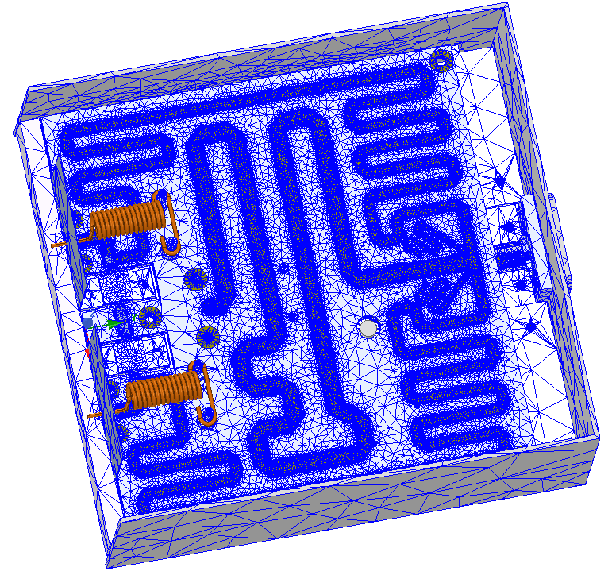
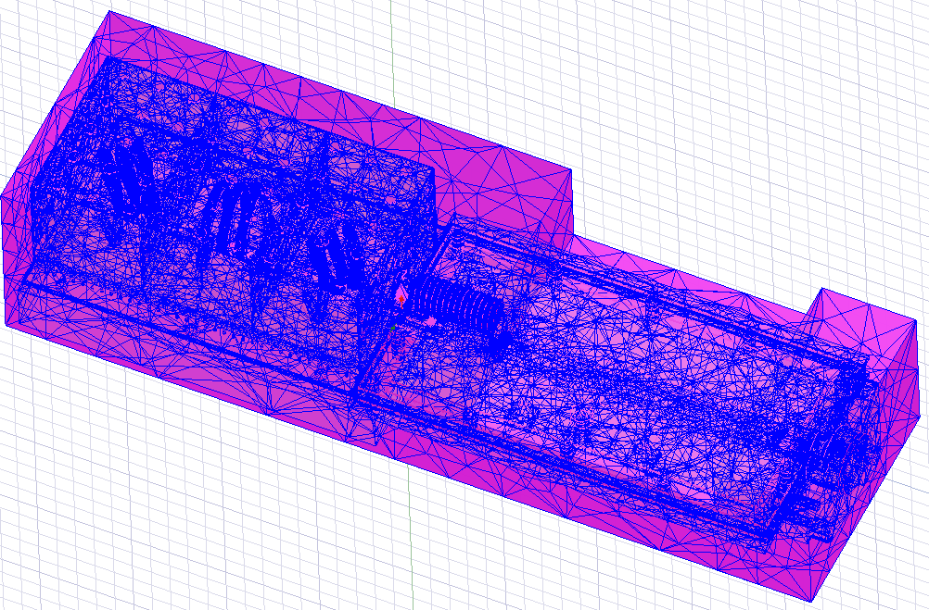
NEW VX Series: Technology tour
Easy Service
Extensive Electromagnetic Modeling:
Efficient Power
Modern Exciter
Advanced RF
Control & UI
VX2 Combiner EM Modeling
Directional Coupler EM Modeling
Affordable
Long-Life Design
Long-Life Design

Slide 9
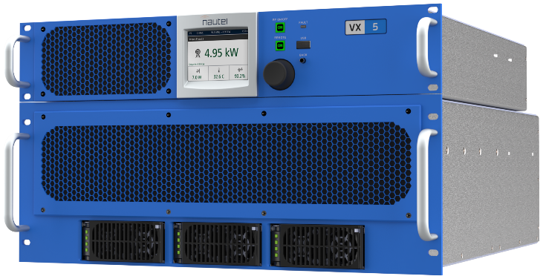
VX 3 – 6 kW
Separate Exciter/Controller
Low weight
Exciter/Controller: 15 lb
Power Section:
65 lb with power supplies
50 lb without power supplies
Easy access serviceability
Fingertip access power supplies
Quick RF pallet access
Front-access washable filters
Solderless PA Pallets

Slide 10
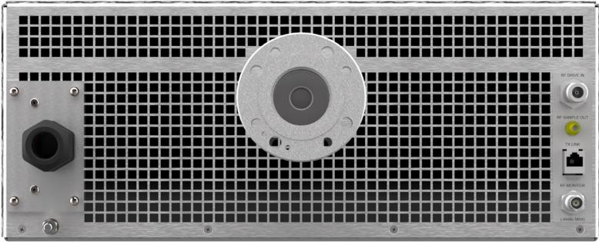
VX 3 – 6 kW
RF Connector: 1-5/8" EIA with removeable field flange (Optional 7/8" EIA adapter​)

Slide 11
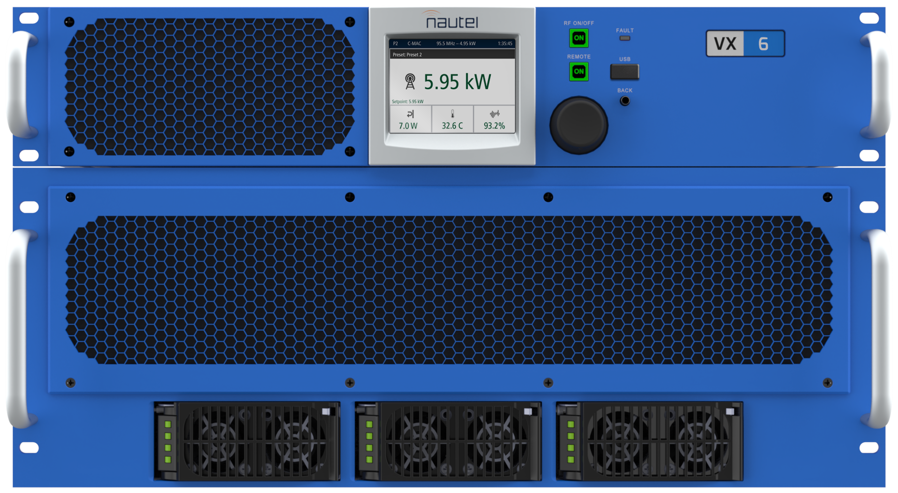
11 NEW VX models!
More Choice
3
3.5
4
5
6
The right TPO to meet your needs

Slide 12
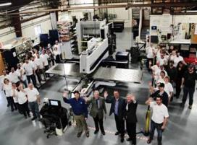
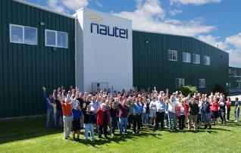
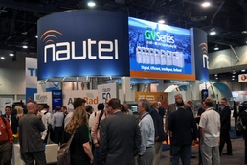
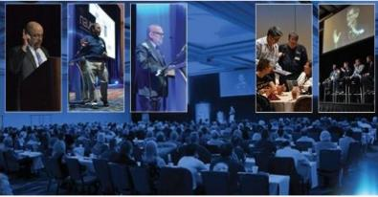
Thank You!
www.nautel.com

