Slide 1
SNMP Putting the Simple back in Simple Network Management Protocol

Slide 2
What is it?
SNMP was developed in 1988
Purpose is to collect and organize data from devices on a network
Can also send information to manage devices and change behaviour
Provides an easy way to monitor and control anything that is connected

Slide 3
What is the structure?
^{Manager}
(MIBs)
Agent
^{(MIB1)}
Agent
^{(MIB2)}
Agent
^{(MIB3)}
Agent
^{(MIB4)}
Device 1
Device 2
Device 3
Device 4

Slide 4
What is the structure?
Managers – poll the agents to retrieve status, or push (SET) commands
Agents/Clients – retrieve information from the devices to send to managers, or take commands from managers and send to devices
Browsers – a visual tool to view the overall activity, to monitor status for each device, or to provide a simple way to send commands to the devices.

Slide 5
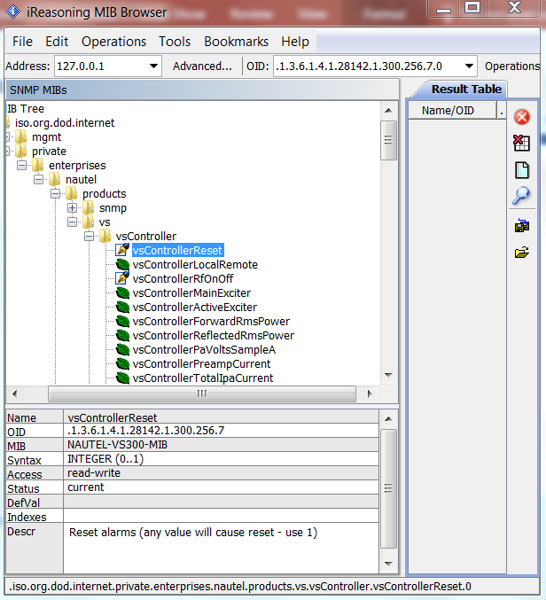
What is the structure?
MIBs
Management Information Base
Everything there is to know in too many numbers!

Slide 6
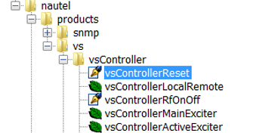
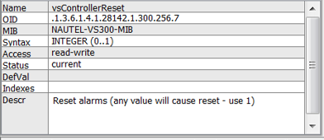
What is the structure?
MIB files
Management Information Base
Predefined structure that stores information that can be queried or set
Work from a very structured address set (OID – or Object Identifier)

Slide 7
What is the structure?
OID: .1.3.6.1.4.1.28142.1.300.256.329.0
1.3.6.1 = iso.org.dod.internet (this will be the same for all devices)
4 = private (1 – directory, 2 – management, 3 – experimental, 5 – security, 6 – SNMPv2, 7 – mail, 8 - features
1 = enterprise
28142 = manufacturer code (Nautel is 28142)
1 =
300 = product identifier (in this case, VS300 transmitter)
256 =
329 =
0 =

Slide 8
What are the commands?
Get
Get Response
Get Next
Walk
Set
Trap
Inform

Slide 9
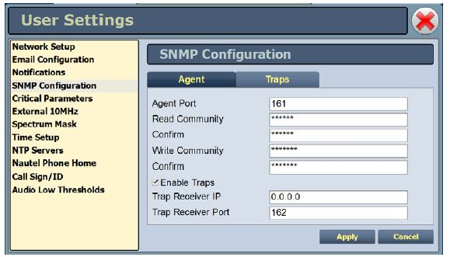
How do we make it work?
Configure devices
Set Community PWs
Enable Traps
Set IP of Manager for receiving Traps

Slide 10
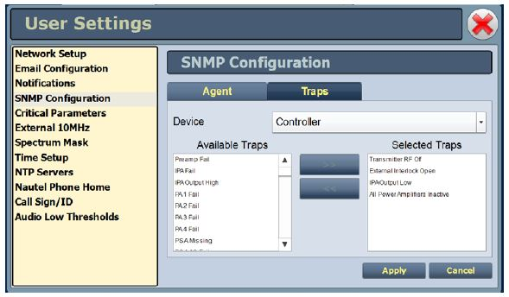
How do we make it work?
Configure devices
For Traps, select what alarms or functions will send notifications to Manager.

Slide 11
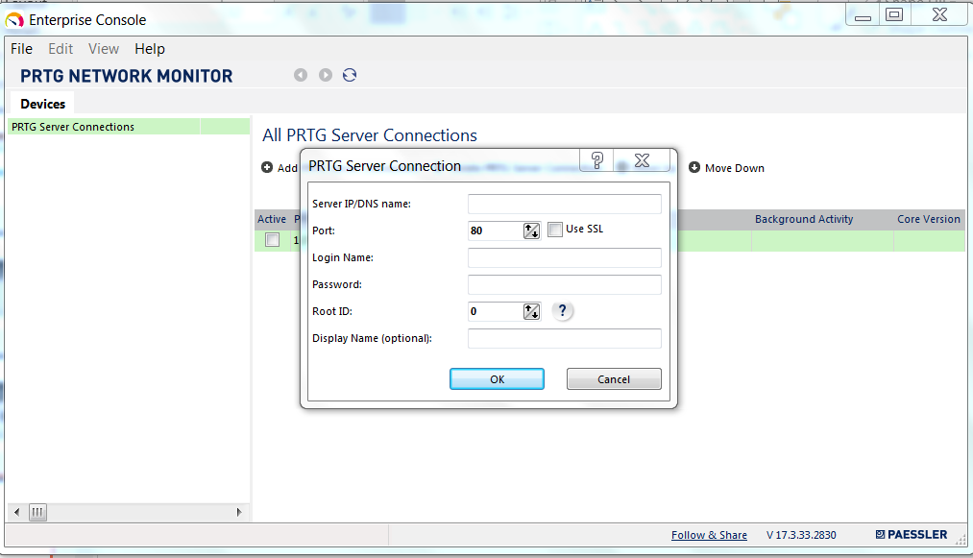
How do we make it work?
Configure Manager
Set Server (Agent) IP address and login info.
Note that some managers will require a password (leaving blank may not be an option!)

Slide 12
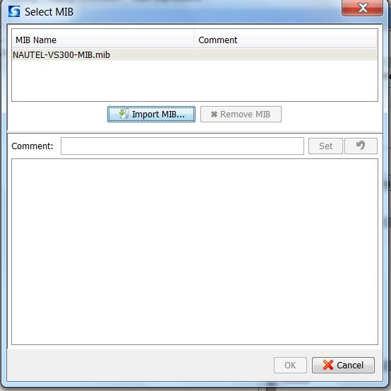
How do we make it work?
Configure Manager
Import (load) MIBs for all client devices

Slide 13
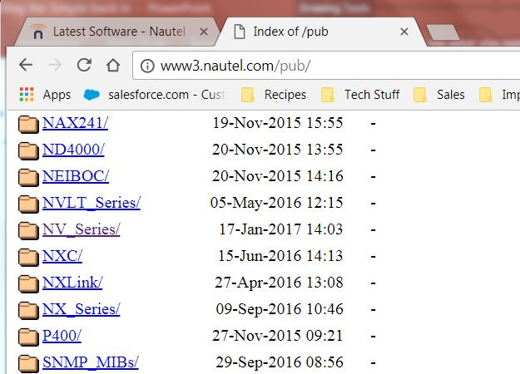
How do we make it work?
Configure Manager
Nautel provides MIBs in FTP site
http://www3.nautel.com/pub/SNMP_MIBs/

Slide 14
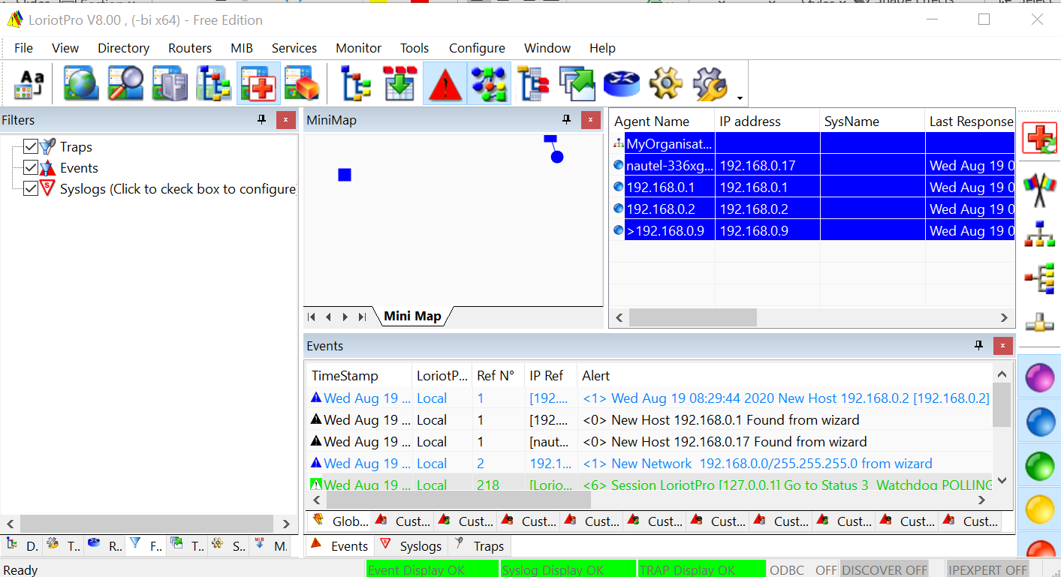
How do we make it work?
There are several IT related managers/browsers
iReasoning
Loriot
PRTG
Zabbex
Etc.

Slide 15
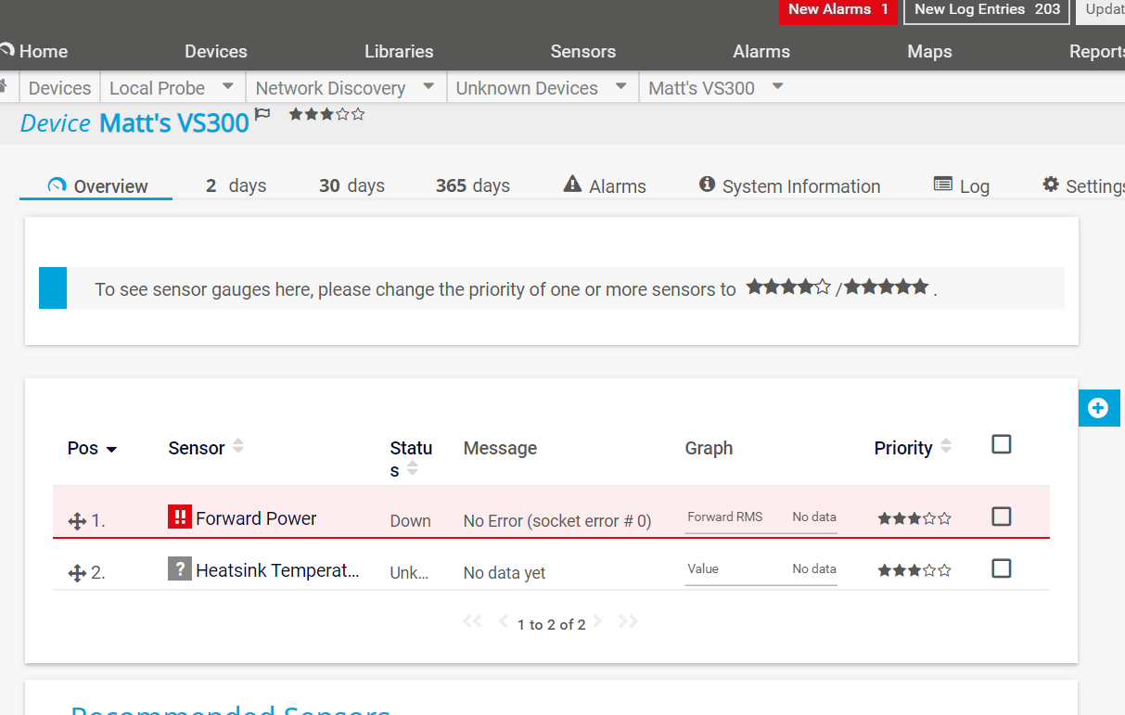
How do we make it work?
Can import MIB
Select what to watch
Or manually enter
Use MIB for reference

Slide 16
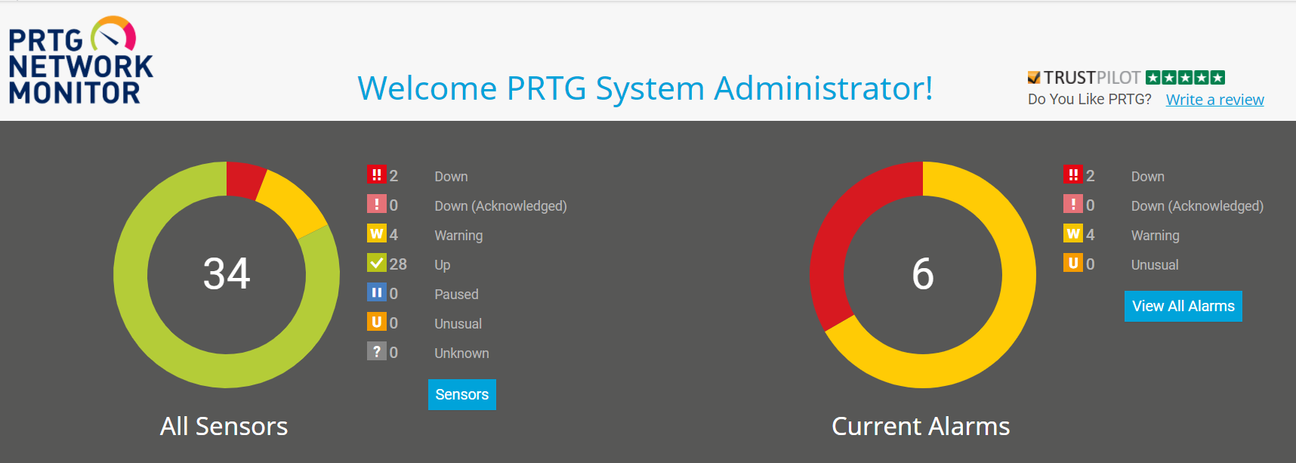
How do we make it work?
Reporting can be as simple (or complex) as you make it

Slide 17
The Gotchas
There are always gotchas. ☺
SNMP requires ports 161 and 162 be open (161 for messages from the manager to the agent, 162 for messages going the other way).
Different managers will require different amounts of configuration
A simple MIB browser needs very little config – but offers little organization
A more complex manager can be configured all the way to putting analog meters up.

Slide 18
Questions?

Slide 19
Online Information
Webinars https://www.nautel.com/resources/webinars/
Nautel Waves Newsletter https://www.nautel.com/newsletters/
YouTube http://www.youtube.com/user/NautelLtd

Slide 20
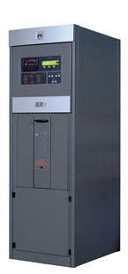
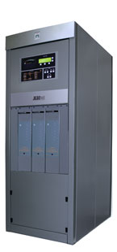
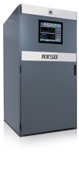
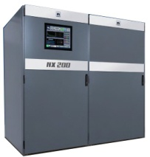
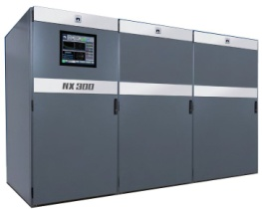
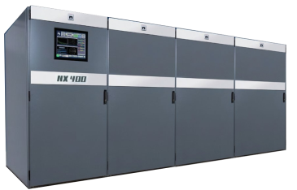
Nautel Major Product Families
XR and NX Series AM transmitters
3kW – 2.0MW
XR3
XR6
XR12
NX25
NX50
NX100
NX200
NX300
NX400
GVSeries FM
VSSeries FM
3.5kW – 88kW
300W – 2.5kW
Advanced User Interface (AUI)
NVLTSeries FM
3.5kW – 10kW
Now all Nautel transmitters are shipped with a
FOUR YEAR WARRANTY!
Notes:
The numbers next to the transmitters indicate wattage, so XR3 = 3000 watts
On NavAids it is different, typically it is 4x power

Slide 21
Thank You

